Slide 1



Leveraging natural disease models to understand human disease
Gordon Huggins, MD
July 19, 2018

Slide 2
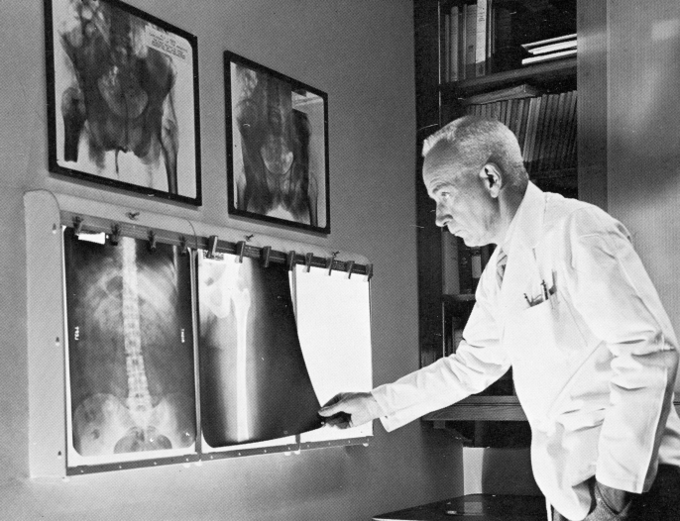
Charles Brenton Huggins, MD
“There is a high incidence of abnormal growth processes – of tumors, in the prostate gland of certain species in senescence. These species are man, the dog and the lion. For technical reasons, observations can be carried out with greater facility on the first two types than on the king of beasts.”
Science 1943; 97: 541.

Slide 3
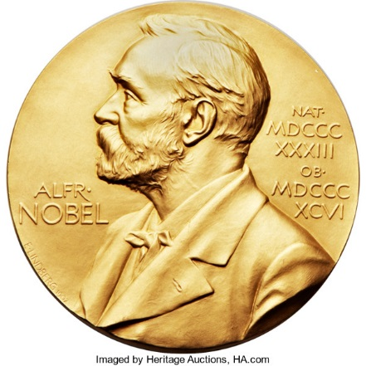
Starting with dogs
The prostate gland is under the control of male sex hormones
Hormone manipulation caused the tumors to shrink
Similar regulation of some forms of breast cancer later discovered
These discoveries formed the basis of hormone therapy prescribed for >50% of breast and prostate cancer
Medicine, 1966

Slide 4
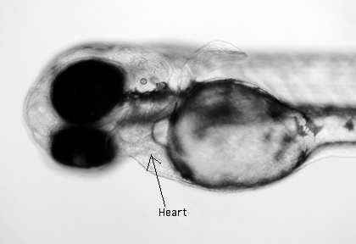
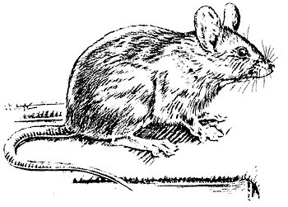
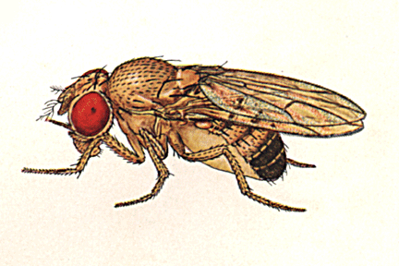
Cardiovascular Biology –
Engineered Animal Models
Drosophila Zebrafish Mouse/Rat
Apart from a few spontaneous disease models in mice the entirety of work on these animals is engineered by man

Slide 5
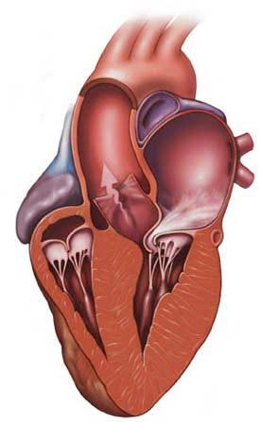
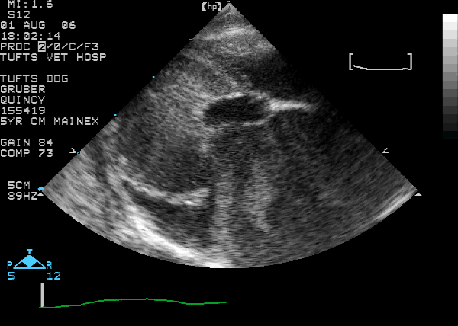
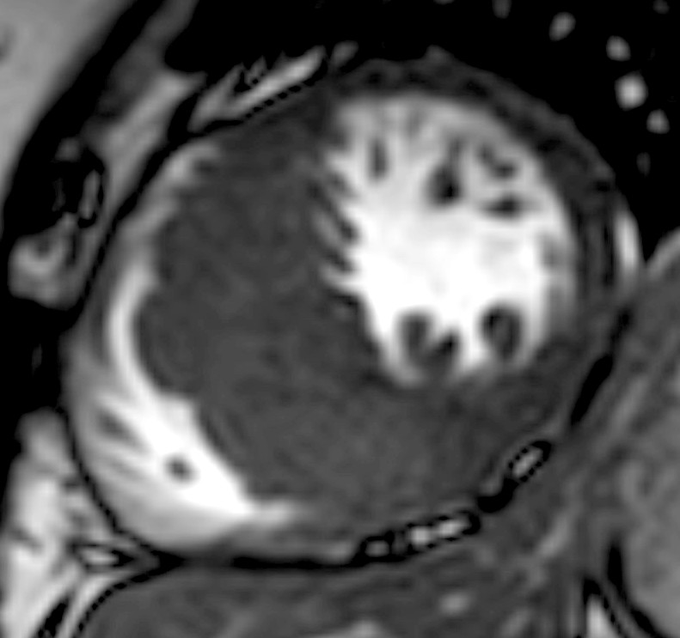
Hypertrophic Cardiomyopathy

Slide 6
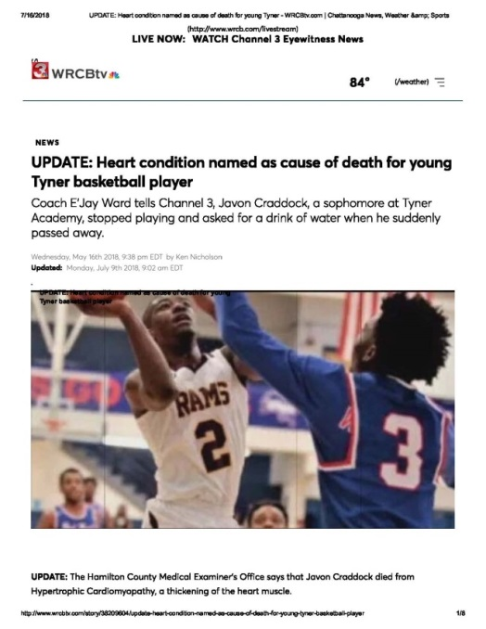
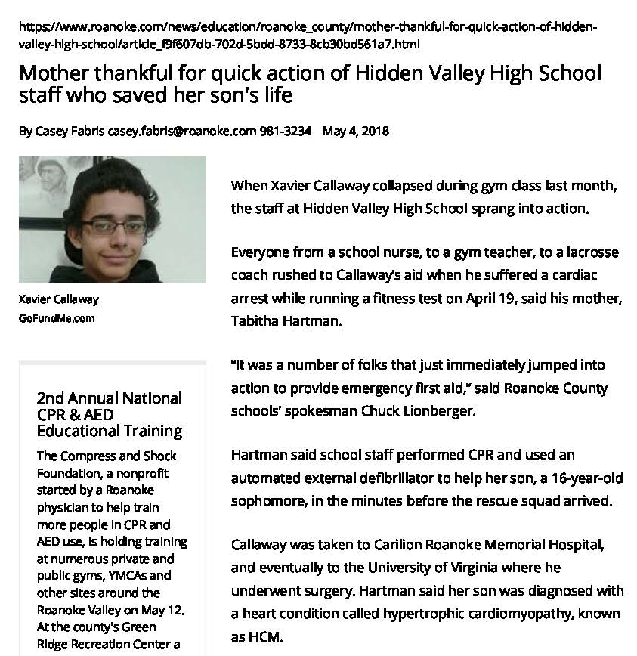
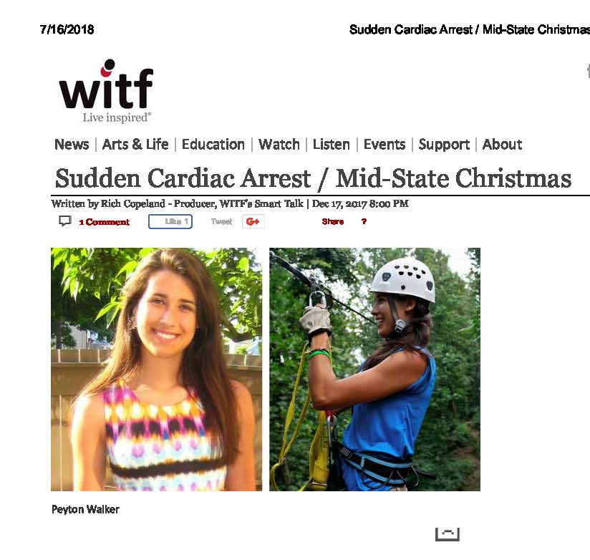
HCM
May 16, 2018
WRCBtv
2500
2000
1500
May 2018
Roanoke Times
No. Affected / Million
1000
500
0
Dec 2017
WITF
HCM
Cystic
Fibrosis
Multiple
Sclerosis
Muscular
Dystrophy
LQTS
Marfan
ALS
Ataxia
Brugada

Slide 7
Tufts Human HCM Study
Studying HCM in the context of human disease
Identified a common gene variant associated with HCM
This gene variant may also influence other forms of hypertrophy that contribute to heart failure
Circ Cardiovasc Genet. 2013; 6:10-18.

Slide 8


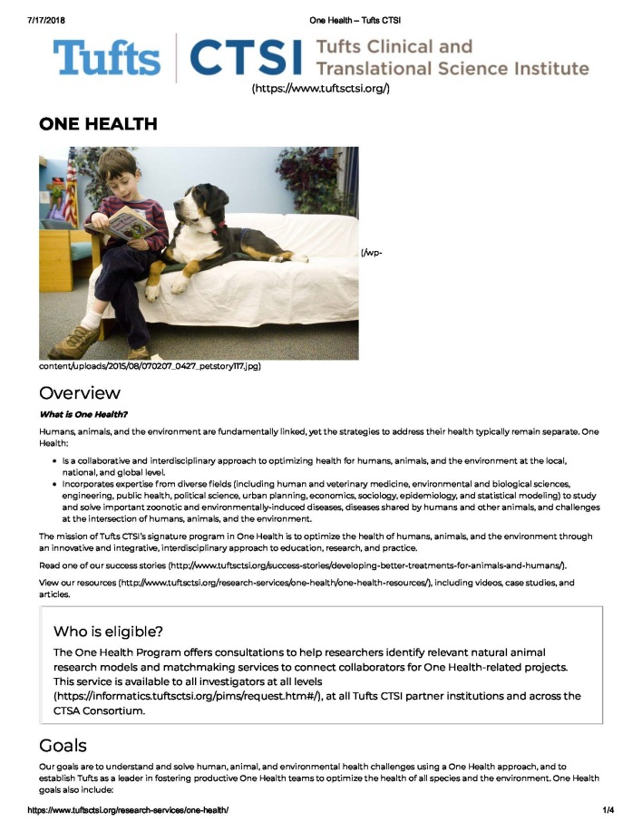
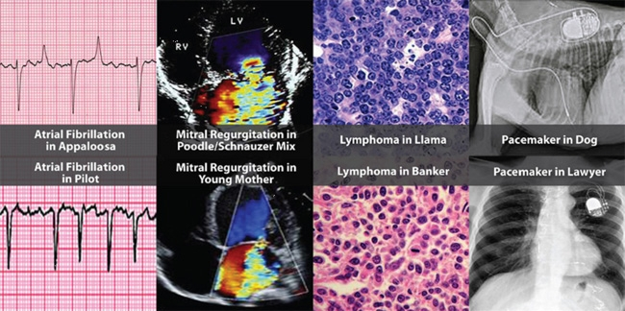
Tufts One Health Program
Training Doctors of Veterinary Medicine in human clinical research (KL2 and TL1 awards)
Zoobiquity explores how human and non-human animal commonalities can be used to diagnose, treat, and heal patients of all species.
An integrated, interdisciplinary approach to physical and behavioral health.
https://www.tuftsctsi.org/research-services/one-health/
http://www.zoobiquity.com/

Slide 9
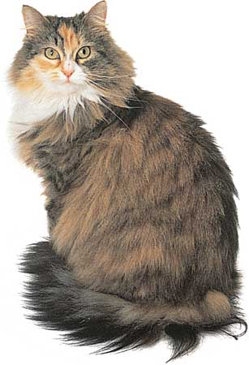
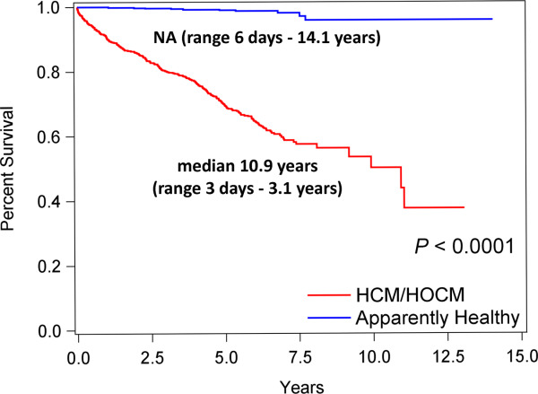

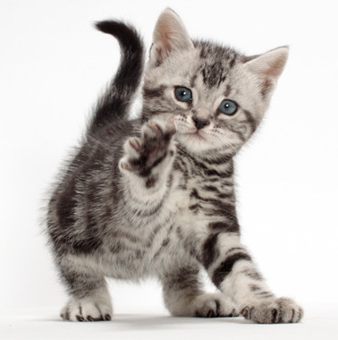
Cats naturally get HCM
J Vet Intern Med 2018 May;32(3):930-943.
Maine Coon Cats, Ragdoll, Short-hair get HCM
Cats with HCM die much earlier than healthy cats (REVEAL Study)
What can we learn from this naturally occurring HCM in cats that could benefit all animals?

Slide 10
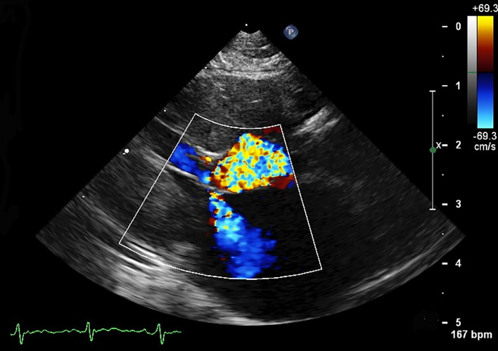
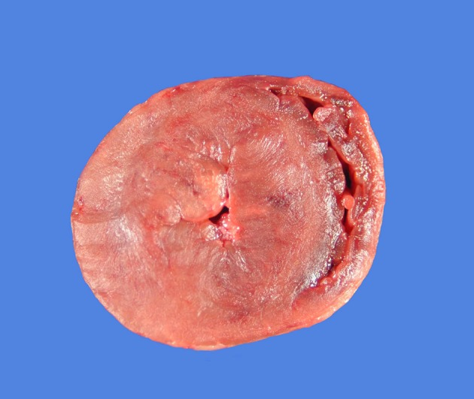
Feline HCM: A spontaneous animal model of Human HCM
FREEMAN, L., RUSH, J., STERN, J., HUGGINS, G., MARON, M.. Feline Hypertrophic Cardiomyopathy: A Spontaneous Large Animal Model of Human HCM. Cardiology Research 2017, 8.

Slide 11

Tufts Feline HCM
Cats with HCM are larger than other cats
  Obese Humans have worse HCM than non-obese patients
Growth hormone pathway is activated in cats with HCM
  Therapies that target growth pathways could be used to treat cats (and perhaps humans) with HCM
Modest changes in diet appear to influence heart size in cats with HCM
  Maybe a dietary change in humans could help?
Dr Lisa Freeman
Tufts Cummings School

Slide 12
Opportunities
The potential for studying naturally occurring animal disease for the benefit of humans is not fully realized
  Public awareness could be improved
Scientific review boards favor more accessible engineered animal models despite their limitations
  Dedicated initiatives that jump-start comparative biology approaches are needed

Slide 13
Questions?

