Slide 1
AAVMC/APTR One Health Interprofessional Education Pet Ownership Risks and Benefits
Robert Ellis, MD, FAAFP
Associate Professor of Family Medicine
University of Cincinnati
Carrie Ellis, DVM, MS
Associate Veterinarian
The Animal Hospital on Mt. Lookout Square
Cincinnati, Ohio

Slide 2
Objectives
Discuss the demographics of pet ownership in the U.S.
Understand the risks and benefits of pet ownership
Enable accurate patient education to minimize risk of zoonotic infections.

Slide 3
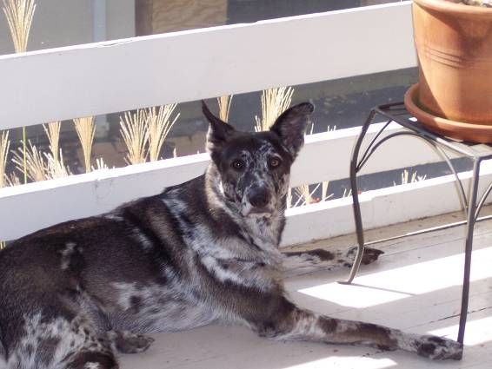
Pets in the U.S.
58.3% of households have a pet
36.1% have dogs
31.6% have cats
60% of pet owning households have 2 or more pets
More pets than children in US households
More common in households with children
Results of the AVMA survey on companion animal ownership in US pet-owning households, JAVMA, Vol 221, No. 11, Dec. 1, 2002.

Slide 4
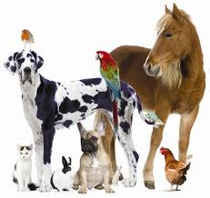
Pets in the U.S.
Cats: 82 million
Dogs: 72 million
Birds: 12 million
Small mammals: 10 million
Horses: 9.2 million
Reptiles: 4 million
Fish: almost 50 million
Over 19 billion chickens on Earth
U.S. Pet Ownership & Demographics Sourcebook (2007 Edition) AVMA
American Horse Council

Slide 5
Why is this important?
Wisconsin Survey
Physicians and Veterinarians (N= 322 and 327)
Physicians “very uncomfortable” educating
about zoonoses
Physicians thought Vets should be equal to more responsible for patient education
Grant S and Olsen C. Preventing Zoonotic Diseases in Immunocompromised Persons: The Role of Physicians and Veterinarians. Emerging Infectious Disease (5:1) 1999.

Slide 6
Why is this important?
Wisconsin Survey
Physicians and Veterinarians (N= 322 and 327)
Physicians “very uncomfortable” educating
about zoonoses
Physicians thought Vets should be equal to more responsible for patient education
Need for better training
Grant S and Olsen C. Preventing Zoonotic Diseases in Immunocompromised Persons: The Role of Physicians and Veterinarians. Emerging Infectious Disease (5:1) 1999.

Slide 7
Why is this important?
Wisconsin Survey
Physicians and Veterinarians (N= 322 and 327)
Physicians “very uncomfortable” educating
about zoonoses
Physicians thought Vets should be equal to more responsible for patient education
Need for better training
Why is this a problem?
Grant S and Olsen C. Preventing Zoonotic Diseases in Immunocompromised Persons: The Role of Physicians and Veterinarians. Emerging Infectious Disease (5:1) 1999.

Slide 8
Why is this important?
Veterinarians often do not know if a client is immunocompromised or has other medical conditions that increase their risk.
Only 21% of HIV patients felt comfortable asking vets about the health risks of pet ownership
St Pierre LA, Kreisle RA, Beck AM. Role of veterinarians in educating immunocompromised clients on the risks and benefits of pet ownership. In: Proceedings of the Geraldine R. Dodge Foundation Gathering and Reports of 1996 Veterinary Student Fellows; 1996 Sep 27-29; Ithaca, New York. Morristown (NJ): The Foundation; 1996.

Slide 9
Why is this important?
Tucson, AZ Survey
Parents (N=231)
Only 42% knew about Salmonella risk with reptiles
Only 35% received info about toxoplasmosis by their obstetrician
58% believed 4 y/o are safe to be left unattended with a dog.
Pediatricians (N=112)
Only 17% reported regularly counseling families about pet related health hazards
86% felt that educating families about pet related health hazards is beneficial. (Barrier: time)
Villar R, et. al. Parent and physician knowledge, attitudes, and practices regaurding pet-associated hazards. Arch Pediatr Adolesc Med. (152:10) 1035-7. Oct. 1998.

Slide 10
Benefit of Animals
Pet owners have 15% fewer doctor visits. (Headey 2007)
Seniors who own pets coped better with stressful life events without entering the healthcare system. (Raina 1998)
Pet owners have lower blood pressure. (Friedmann 1983, Anderson 1992)
Pet owners have lower triglyceride and cholesterol levels than non-owners. (Anderson, 1992)

Slide 11
Benefit of Animals
Pet owners have a higher one-year survival rates following coronary heart disease. (Friedman, 1980, 1995)
Children exposed to pets during the first year of life have a lower frequency of allergic rhinitis and asthma. (Hesselmar 1999, Celedon 2002, Perzanowski 2002, Gern 2006, Wegienka 2011)
People who have AIDS that have pets have less depression and reduced stress. (Siegel 1999, Carmack 1991)
Dog owners were more likely to be physically active.

Slide 12
Benefit of Animals
Seniors who own dogs require less doctor visits. (Siegel 1990)
Human health savings of $3.86 billion over 10 years have been linked to pet ownership as related to a decrease in doctor visits in studies in Austria and Germany (Heady, 2002)

Slide 13
Special Populations
Immunocompromised
Diabetic mellitus
Young children
Elderly

Slide 14
Special Populations
Immunocompromised
Diabetic mellitus
Young children
Elderly
Who do we consider immunocompromised?

Slide 15
Special Populations
Immunocompromised
Diabetic mellitus
Young children
Elderly
Who do we consider immunocompromised?
HIV positive patients
Patients on chronic oral steroids
Patients with cancer during active treatment
Patients with previous organ transplant
Other immunosuppressant medications
Methotrexate, TNF blocker, etc

Slide 16
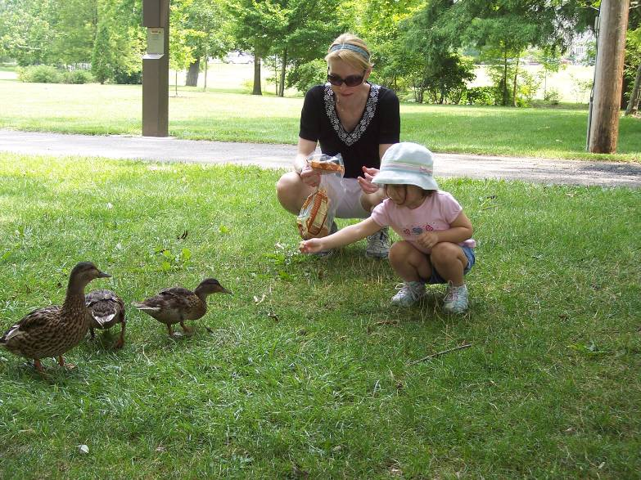
Patients with HIV and Immunocompromised
Do not have to give up their pets (SOR AII)
Although the risks are low, you can get an infection from pets or other animals.
Simple precautions.
HIV can not be spread by, or to, cats, dogs, birds, or other pets.
Panel on Opportunistic Infections in HIV-Infected Adults and Adolescents. Guidelines for the prevention and treatment of opportunistic infections in HIV-infected adults and adolescents:
recommendations from the Centers for Disease Control and Prevention, the National Institutes of Health, and the HIV Medicine Association of the Infectious Diseases Society of America.
Available at http://aidsinfo.nih.gov/contentfiles/lvguidelines/adult_oi.pdf. Accessed 10/21/15.
Guidelines for preventing infectious complication among hematopoietic cell transplant recipients: a global perspective. Biol Blood Marrow Transplant 15: 1143-1238 (2009)

Slide 17
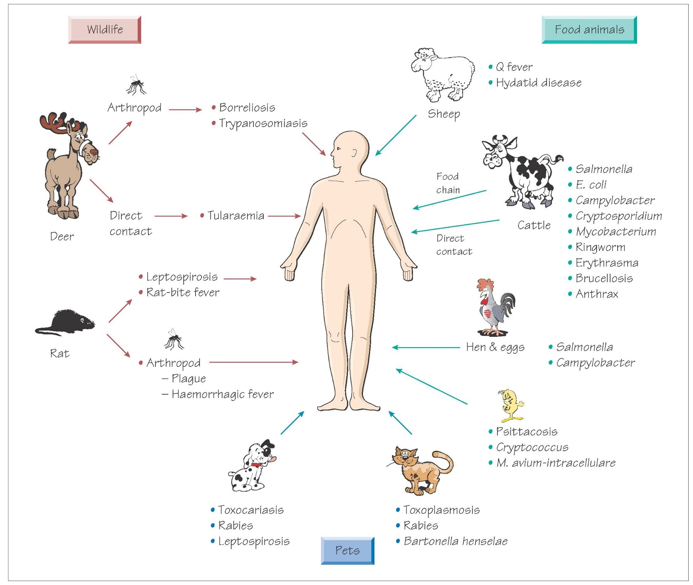
Patients with HIV and Immunocompromised
Potential infections
Cryptosporidiosis
Toxoplasmosis
Mycobacterium avium complex
Giardiasis
Salmonellosis
Campylobacteriosis
other diseases
Panel on Opportunistic Infections in HIV-Infected Adults and Adolescents. Guidelines for the prevention and treatment of opportunistic infections in HIV-infected adults and adolescents:
recommendations from the Centers for Disease Control and Prevention, the National Institutes of Health, and the HIV Medicine Association of the Infectious Diseases Society of America.
Available at http://aidsinfo.nih.gov/contentfiles/lvguidelines/adult_oi.pdf. Accessed 10/21/15.
Guidelines for preventing infectious complication among hematopoietic cell transplant recipients: a global perspective. Biol Blood Marrow Transplant 15: 1143-1238 (2009)

Slide 18
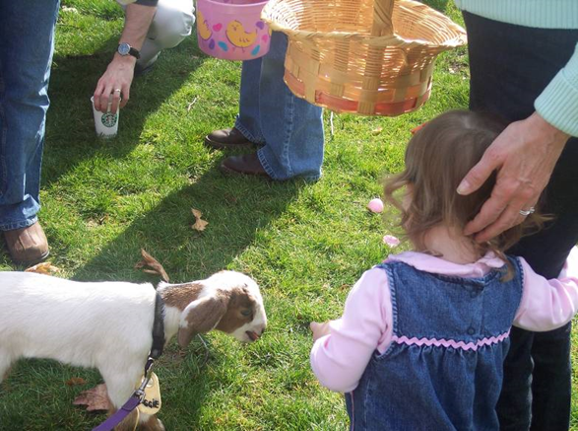
Patients with HIV and Immunocompromised
Preventative measures (SOR IIIB)
Wash hands
Only feed commercial pet food
Avoid pets with diarrhea
Avoid pets <6 m/o
Avoid stray animals
Don’t touch their stool
Keep cat’s nails clipped
Keep fleas off pets
Don’t let pets lick your face
Wear gloves when cleaning
Clean litter box/cage liners daily
Regular Veterinary Exams
Panel on Opportunistic Infections in HIV-Infected Adults and Adolescents. Guidelines for the prevention and treatment of opportunistic infections in HIV-infected adults and adolescents:
recommendations from the Centers for Disease Control and Prevention, the National Institutes of Health, and the HIV Medicine Association of the Infectious Diseases Society of America.
Available at http://aidsinfo.nih.gov/contentfiles/lvguidelines/adult_oi.pdf. Accessed 10/21/15.
Guidelines for preventing infectious complication among hematopoietic cell transplant recipients: a global perspective. Biol Blood Marrow Transplant 15: 1143-1238 (2009)

Slide 19
Patients with HIV and Immunocompromised
Pets to generally avoid
Reptiles, including lizards, snakes, and turtles
Baby chicks and ducklings
Exotic pets (monkeys, etc.)
Wild Animals
Extra caution with Farm animals including petting zoos
Panel on Opportunistic Infections in HIV-Infected Adults and Adolescents. Guidelines for the prevention and treatment of opportunistic infections in HIV-infected adults and adolescents:
recommendations from the Centers for Disease Control and Prevention, the National Institutes of Health, and the HIV Medicine Association of the Infectious Diseases Society of America.
Available at http://aidsinfo.nih.gov/contentfiles/lvguidelines/adult_oi.pdf. Accessed 10/21/15.
Guidelines for preventing infectious complication among hematopoietic cell transplant recipients: a global perspective. Biol Blood Marrow Transplant 15: 1143-1238 (2009)

Slide 20
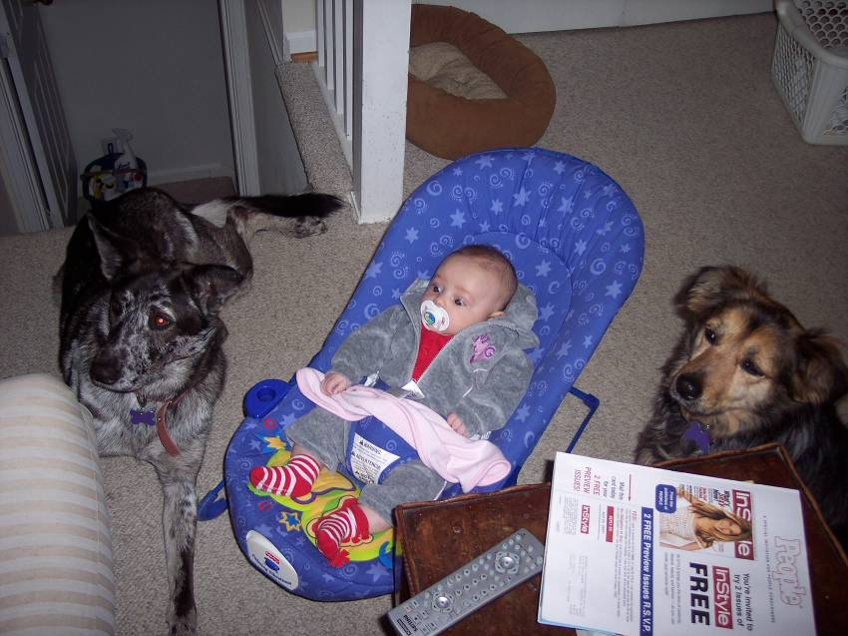
Infants and Young Children (Younger than 5 y/o)
Supervised while interacting with animals.
Children should not be allowed to kiss pets or to put their hands or other objects into their mouths after handling animals.
Wash hands after contact with animals.
What’s wrong with this picture?

Slide 21
Infants and Young Children (Younger than 5 y/o)
Supervised while interacting with animals.
Children should not be allowed to kiss pets or to put their hands or other objects into their mouths after handling animals.
Wash hands after contact with animals.
2 dogs
No adults
What’s wrong with this picture?

Slide 22
Infants and Young Children (Younger than 5 y/o)
Supervised while interacting with animals.
Children should not be allowed to kiss pets or to put their hands or other objects into their mouths after handling animals.
Wash hands after contact with animals.
Also, bouncer too close to stairs
2 dogs
No adults
What’s wrong with this picture?

Slide 23
Infants and Young Children (Younger than 5 y/o)
CDC recommends to avoid contact with…
Reptiles (lizards, snakes and turtles)
Amphibians (frogs, toads, newts, and salamanders)
Chicks and ducklings
Petting zoos

Slide 24
Infants and Young Children (Younger than 5 y/o)
CDC recommends to avoid contact with…
Reptiles (lizards, snakes and turtles)
Amphibians (frogs, toads, newts, and salamanders)
Chicks and ducklings
Petting zoos
Not realistic:
I let my kids go.
Wash/sanitize hands immediately after and keep child’s hands out of his/her mouth.

Slide 25
Elderly
Often prone to infections
Decreased strength
Poorer balance
Thinner and more fragile skin
Frequently on blood thinning medications
Decreased sensory perception
Grandparent’s pet may not be socialized to small children

Slide 26
Case Example
The NC Division of Public Health was notified of a cluster of 3 cases on hemolytic uremic syndrome caused by E. coli O157: H7.
Upon investigation, with the help of local health departments, they identified 108 persons how became ill with a diarrheal illness. 78% of them visited a petting zoo (goats and sheep) at the state fair. 38 individuals were confirmed to have the same E. coli isolates
Environmental sampling found E. coli extensive contamination of one of the 2 petting zoos.
A case-control study was done to identify risk factors for infection using controls (fair attendees that had no illness).
No food, beverage, or recreational water was associated with illness.
Illness was associated with touching or stepping on manure, falling or sitting on the ground, and use of pacifier, sippy cup or sucking thumb while in the petting zoo.
Alcohol based hand sanitizer use was not protective
Reported awareness (by adult who accompanied child) of risk for disease from contact with livestock was preventive.

Slide 27
Discussion questions
Based on this case, how can health professions (physicians, veterinarians, health professional) work together to prevent further petting zoo related outbreaks in the future?
A local group is setting up a petting zoo at their summer festival. They plan to have goats, sheep, potbelly pigs, chicks, and rabbits. They are asking you for help to ensure the safety of their attendees. What specific recommendations would you give to decrease the likelihood of a petting zoo related infection?

Slide 28
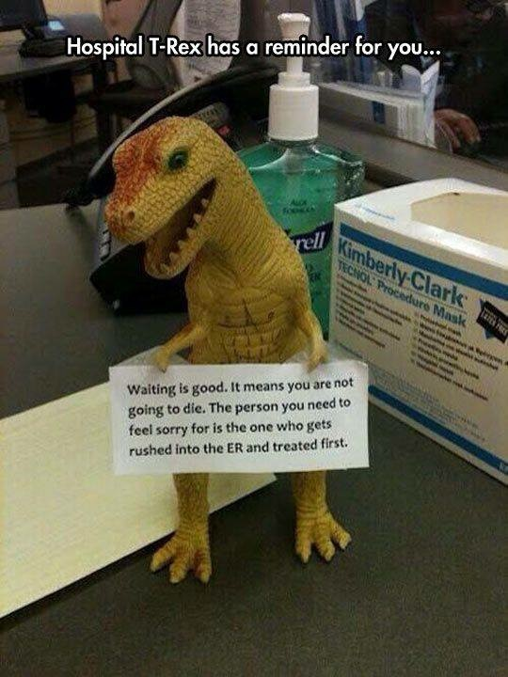
Summary
All physician, veterinary, and health professionals share in the responsibility of educating people on healthy human and animal interactions.
For most people the benefits outweigh the risk of pet ownership
Taking simple precautions can minimize potential risks.

