Slide 1
AAVMC/APTR One Health Interprofessional Education Zoonotic Infections
Robert Ellis, MD, FAAFP
Associate Professor of Family Medicine
University of Cincinnati
Carrie Ellis, DVM, MS
Associate Veterinarian
The Animal Hospital on Mt. Lookout Square
Cincinnati, Ohio

Slide 2
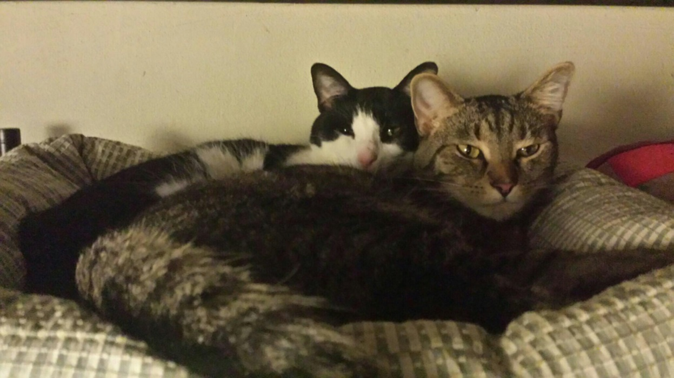
Objectives
Recognize common zoonotic infections
Understand the treatment of common zoonotic infections
Enabled to counsel patients/owners on preventing common zoonotic infections.

Slide 3
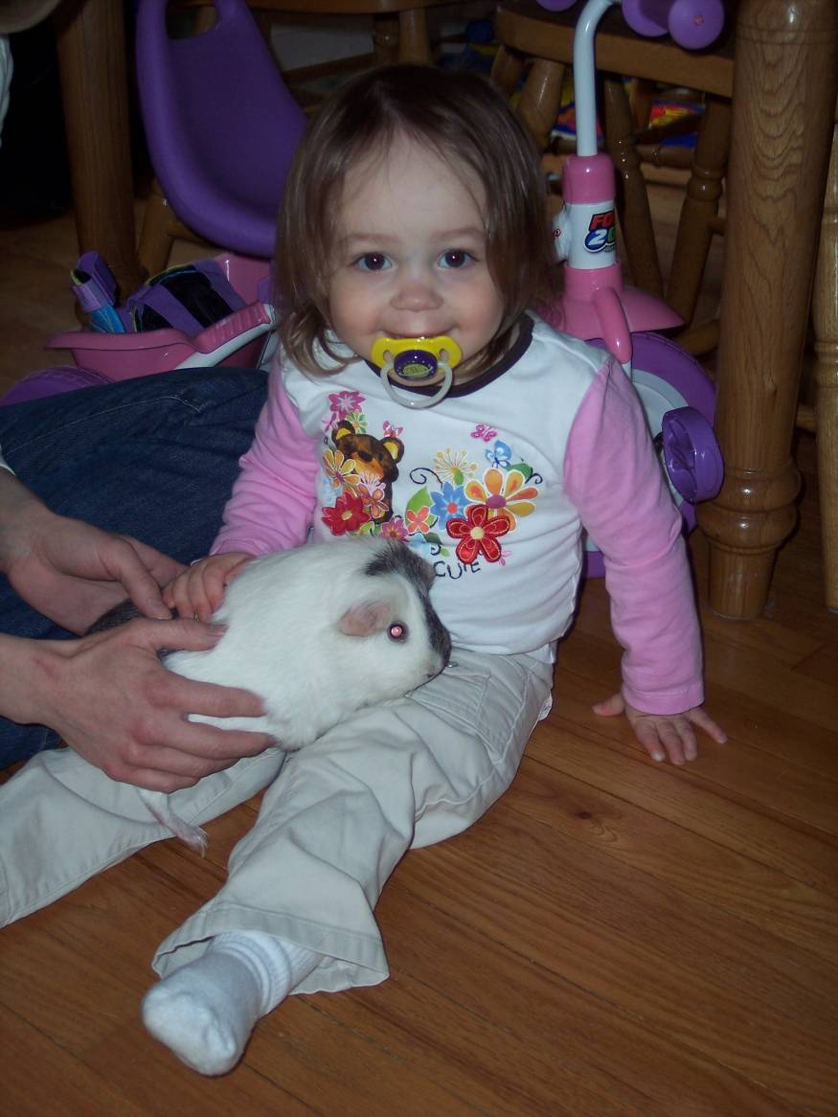
Zoonotic Infections Discussed
Toxoplasmosis
Cat scratch disease
Leptospirosis
Worms
Tinea (ringworm)
Mites/Scabies
MRSA
Rabies (in animal bites lecture)

Slide 4
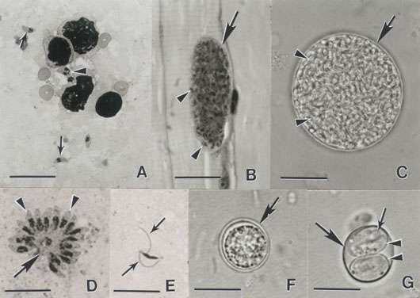
Toxoplasmosis
Caused by a parasite (Toxoplasma gondii)
Prevalent worldwide
Carried by cats and
is passed in their feces
Sporulation takes 1-5 days
Cats shed oocysts for 2 weeks
Oocysts can survive for years in the environment
Antibody testing of cats has little to no public health value.
Courtesy USDA, http://www.ars.usda.gov/Main/docs.htm?docid=11013
Jones JL, Kruszon-Moran D, Wilson M. Toxoplasma gondii infection in the United States, 1999–2000. Emerg Infect Dis [9:11] 2003 Nov [8/7/07]. Available from: URL: http://www.cdc.gov/ncidod/EID/vol9no11/03-0098.htm
MMWR Recommendations and Reports, Preventing Congenital Toxoplasmosis March 31, 2000 / 49(RR02);57-75 http://www.cdc.gov/ncidod/dpd/parasites/toxoplasmosis/factsht_toxoplasmosis.htm

Slide 5
Toxoplasmosis
Caused by a parasite (Toxoplasma gondii)
Prevalent worldwide
Carried by cats and
is passed in their feces
Sporulation takes 1-5 days
Cats shed oocysts for 2 weeks
Oocysts can survive for years in the environment
Antibody testing of cats has little to no public health value.
Toxo is not infectious until it sporulates!
Cleaning/scooping the litter box daily will minimize the risk of toxo exposure.
Courtesy USDA, http://www.ars.usda.gov/Main/docs.htm?docid=11013
Jones JL, Kruszon-Moran D, Wilson M. Toxoplasma gondii infection in the United States, 1999–2000. Emerg Infect Dis [9:11] 2003 Nov [8/7/07]. Available from: URL: http://www.cdc.gov/ncidod/EID/vol9no11/03-0098.htm
MMWR Recommendations and Reports, Preventing Congenital Toxoplasmosis March 31, 2000 / 49(RR02);57-75 http://www.cdc.gov/ncidod/dpd/parasites/toxoplasmosis/factsht_toxoplasmosis.htm

Slide 6
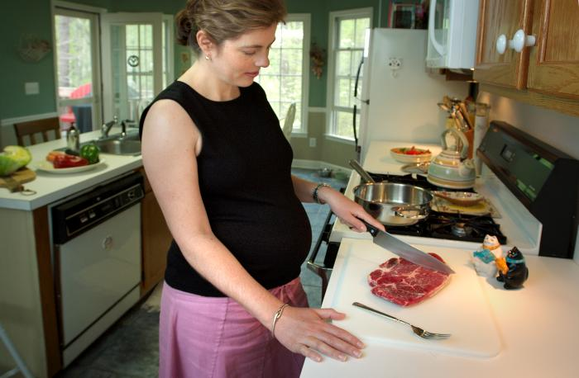
Toxoplasmosis
Approximately 20% U.S. seropositive
Most asymptomatic
750 deaths attributed to toxoplasmosis each year
Eating undercooked meat accounts for >50% of infections
(2rd leading cause of foodborne deaths in the U.S.)
Highest risk: immunocompromised, young, fetus, pregnant
Courtesy CDC, no copyright.
Jones JL, Kruszon-Moran D, Wilson M. Toxoplasma gondii infection in the United States, 1999–2000. Emerg Infect Dis [9:11] 2003 Nov [8/7/07]. Available from: URL: http://www.cdc.gov/ncidod/EID/vol9no11/03-0098.htm
MMWR Recommendations and Reports, Preventing Congenital Toxoplasmosis March 31, 2000/ 49(RR02);57-75
CDC.gov

Slide 7
Toxoplasmosis
European countries can be as high as 60-85%.
Approximately 20% U.S. seropositive
Most asymptomatic
750 deaths attributed to toxoplasmosis each year
Eating undercooked meat accounts for >50% of infections
(2rd leading cause of foodborne deaths in the U.S.)
Highest risk: immunocompromised, young, fetus, pregnant
Courtesy CDC, no copyright.
Jones JL, Kruszon-Moran D, Wilson M. Toxoplasma gondii infection in the United States, 1999–2000. Emerg Infect Dis [9:11] 2003 Nov [8/7/07]. Available from: URL: http://www.cdc.gov/ncidod/EID/vol9no11/03-0098.htm
MMWR Recommendations and Reports, Preventing Congenital Toxoplasmosis March 31, 2000/ 49(RR02);57-75
CDC.gov

Slide 8
Toxoplasmosis
European countries can be as high as 60-85%.
Approximately 20% U.S. seropositive
Most asymptomatic
750 deaths attributed to toxoplasmosis each year
Eating undercooked meat accounts for >50% of infections
(2rd leading cause of foodborne deaths in the U.S.)
Highest risk: immunocompromised, young, fetus, pregnant
Courtesy CDC, no copyright.
If you like your meat a little on the rare side, you are at risk.
Jones JL, Kruszon-Moran D, Wilson M. Toxoplasma gondii infection in the United States, 1999–2000. Emerg Infect Dis [9:11] 2003 Nov [8/7/07]. Available from: URL: http://www.cdc.gov/ncidod/EID/vol9no11/03-0098.htm
MMWR Recommendations and Reports, Preventing Congenital Toxoplasmosis March 31, 2000/ 49(RR02);57-75
CDC.gov

Slide 9
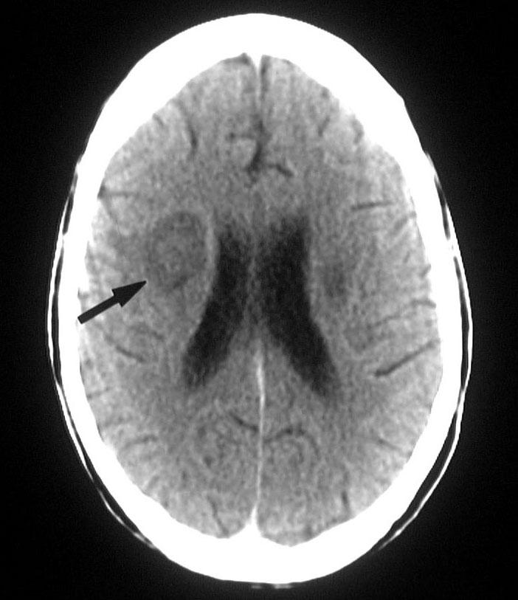
Toxoplasmosis Infection
Most are asymptomatic
Symptoms: swollen glands, muscle aches and flu-like symptoms
Severe infections can damage the brain, eyes, and other organs
Can be acute or latent infection

Slide 10
Toxoplasmosis Infection
Most are asymptomatic
Symptoms: swollen glands, muscle aches and flu-like symptoms
Severe infections can damage the brain, eyes, and other organs
Can be acute or latent infection
Latent infections most commonly happen in acquired immunodeficiency
(HIV, starting immunosuppressant medications, etc)

Slide 11
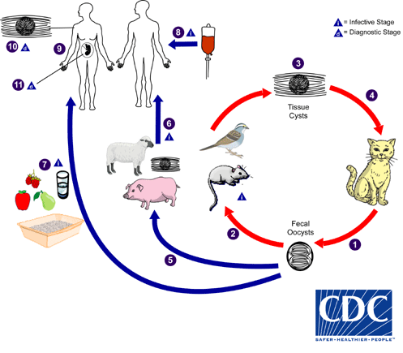
Even a 100% indoor cat can be exposed to toxo. This one’s a good mouser!

Slide 12
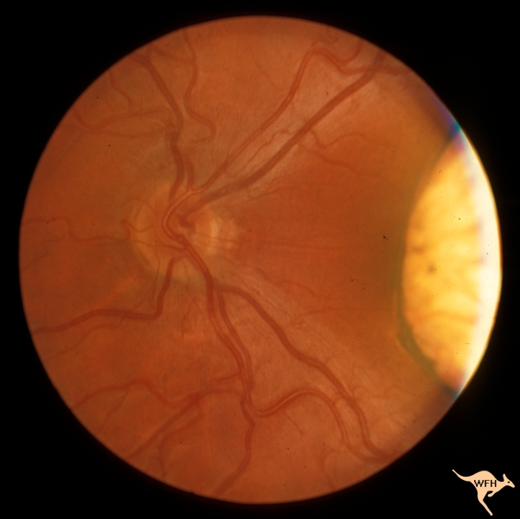
Congenital Toxoplasmosis
400-4000 annually in the U.S.
Sequelae
Death
learning disabilities (1-2%)
chorioretinitis (4-27%)
Most infants are asymptomatic
classic triad
Chorioretinitis
Hydrocephalus
intracranial calcifications
Infection during pregnancy
Spiramycin
Newborn infection
Pyrimethamine, sulfadiazine, and leucovorin
Displayed with permission
William F. Hoyt, MD and North American Neuro-Ophthalmology Society (NANOS) http://creativecommons.org/licenses/by-nc-nd/2.0/
MMWR Recommendations and Reports, Preventing Congenital Toxoplasmosis March 31, 2000/ 49(RR02);57-75

Slide 13
Congenital Toxoplasmosis
This lesion would not be seen without a slight lamp unless you are very through with your exam.
400-4000 annually in the U.S.
Sequelae
Death
learning disabilities (1-2%)
chorioretinitis (4-27%)
Most infants are asymptomatic
classic triad
Chorioretinitis
Hydrocephalus
intracranial calcifications
Infection during pregnancy
Spiramycin
Newborn infection
Pyrimethamine, sulfadiazine, and leucovorin
Displayed with permission
William F. Hoyt, MD and North American Neuro-Ophthalmology Society (NANOS) http://creativecommons.org/licenses/by-nc-nd/2.0/
MMWR Recommendations and Reports, Preventing Congenital Toxoplasmosis March 31, 2000/ 49(RR02);57-75

Slide 14
Toxoplasmosis Animal Infections
Most cats are asymptomatic
Pulmonary
Diffuse interstitial to alveolar patters or pleural effusion
Ocular
Anterior/posterior uveitis
CNS
Behavioral changes, blindness, ataxia, seizures
Treatment in Cats
No approved treatments
Sulphonamides, trimethoprim, pyrimethamine, and clindamycin, either alone or in combination have been used
Elmore S, et at. Toxoplasmosis gondii: epidemiology, feline clinical aspects, and prevention. Trends Parasito 26 (4) 190-196. 2010.

Slide 15
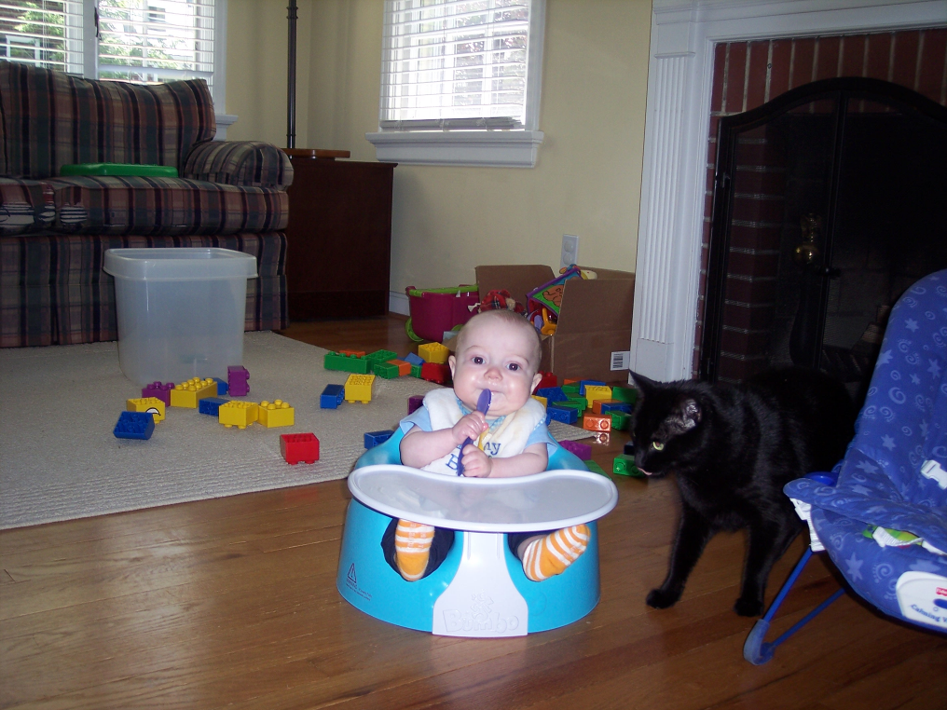
Toxoplasmosis Animal Infections
Treatment
Ocular: clindamycin
CNS: clindamycin or sulfanamide + pyrimethamine

Slide 16
Toxoplasmosis Prevention
Safety Tips if pregnant (SOR IIIB)
Cook meats thoroughly
Wash fruits and vegetables
Wear gloves when gardening
Have non-pregnant person (if possible) change
litter box daily
Wear gloves when cleaning litter box
Wash hands
Keep cats indoors
Avoid adopting or handling stray cats
Feed cats only canned or dried commercial cat food, never undercooked or raw meat
Do not bring a new cat into your house that might have been an outdoor cat or might have been fed raw meat
Courtesy CDC, no copyright.
www.cdc.gov/ncidod/dpd/parasites/toxoplasmosis
Brochure developed by the Centers for Disease Control and Prevention and in collaboration with the Minnesota Department of Health. February 2003.

Slide 17
Toxoplasmosis Prevention
There is minimal risk from your cat if you follow these recommendations!
Safety Tips if pregnant (SOR IIIB)
Cook meats thoroughly
Wash fruits and vegetables
Wear gloves when gardening
Have non-pregnant person (if possible) change
litter box daily
Wear gloves when cleaning litter box
Wash hands
Keep cats indoors
Avoid adopting or handling stray cats
Feed cats only canned or dried commercial cat food, never undercooked or raw meat
Do not bring a new cat into your house that might have been an outdoor cat or might have been fed raw meat
Courtesy CDC, no copyright.
www.cdc.gov/ncidod/dpd/parasites/toxoplasmosis
Brochure developed by the Centers for Disease Control and Prevention and in collaboration with the Minnesota Department of Health. February 2003.

Slide 18
Toxoplasmosis Prevention
There is minimal risk from your cat if you follow these recommendations!
Safety Tips if pregnant (SOR IIIB)
Cook meats thoroughly
Wash fruits and vegetables
Wear gloves when gardening
Have non-pregnant person (if possible) change
litter box daily
Wear gloves when cleaning litter box
Wash hands
Keep cats indoors
Avoid adopting or handling stray cats
Feed cats only canned or dried commercial cat food, never undercooked or raw meat
Do not bring a new cat into your house that might have been an outdoor cat or might have been fed raw meat
Little risk if already seropositive.
No recommendation for routine testing of pregnant women or occupational exposure
Data shows veterinarian seropositive rate equal to the general population
Some data for testing HIV patients and those undergoing bone marrow transplant
Courtesy CDC, no copyright.
www.cdc.gov/ncidod/dpd/parasites/toxoplasmosis
Brochure developed by the Centers for Disease Control and Prevention and in collaboration with the Minnesota Department of Health. February 2003.

Slide 19
Cat Scratch Fever

Slide 20
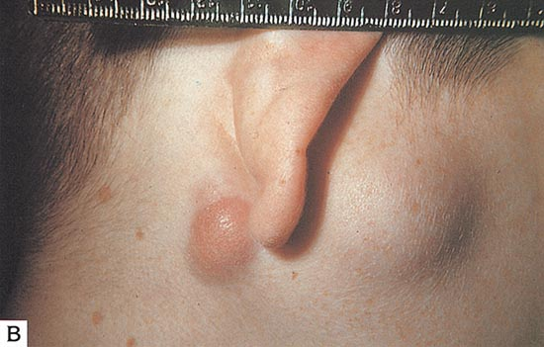
Cat Scratch Disease
Bartonella henselae
Bitten or scratched by an infected cat
Also shown to be directly transmitted from a flea or ticks bite
Annual incidence: 9.3 per 100,000
About 25,000 case annually in U.S.
4 – 6% seropositive in the U.S.
Peak incidence: fall and early winter
40% of cats carry B. henselae
(up to 90% cat <1 y/o)
Cats are usually asymptomatic
Flea dirt (feces)
Skerget M, Wenisch C, Daxboeck F, Krause R, Haberl R, Stuenzner D. Cat or dog ownership and seroprevalence of ehrlichiosis, Q fever, and cat-scratch disease. Emerg Infect Dis [9:10] 2003 Oct [8/7/07]. Available from: URL: http://www.cdc.gov/ncidod/EID/vol9no10/03-0206.htm

Slide 21
Cat Scratch Disease
The flea is the definitive host. Get rid of the flea and no longer at risk for cat scratch disease. Regularly use your veterinarian recommended flea and tick control.
Bartonella henselae
Bitten or scratched by an infected cat
Also shown to be directly transmitted from a flea or ticks bite
Annual incidence: 9.3 per 100,000
About 25,000 case annually in U.S.
4 – 6% seropositive in the U.S.
Peak incidence: fall and early winter
40% of cats carry B. henselae
(up to 90% cat <1 y/o)
Cats are usually asymptomatic
Flea dirt (feces)
Skerget M, Wenisch C, Daxboeck F, Krause R, Haberl R, Stuenzner D. Cat or dog ownership and seroprevalence of ehrlichiosis, Q fever, and cat-scratch disease. Emerg Infect Dis [9:10] 2003 Oct [8/7/07]. Available from: URL: http://www.cdc.gov/ncidod/EID/vol9no10/03-0206.htm

Slide 22
Cat Scratch Disease
The flea is the definitive host. Get rid of the flea and no longer at risk for cat scratch disease. Regularly use your veterinarian recommended flea and tick control.
Bartonella henselae
Bitten or scratched by an infected cat
Also shown to be directly transmitted from a flea or ticks bite
Annual incidence: 9.3 per 100,000
About 25,000 case annually in U.S.
4 – 6% seropositive in the U.S.
Peak incidence: fall and early winter
40% of cats carry B. henselae
(up to 90% cat <1 y/o)
Cats are usually asymptomatic
Flea dirt (feces)
In some areas, fleas are now resistant to certain flea and tick prevention. Check with a local expert.
Skerget M, Wenisch C, Daxboeck F, Krause R, Haberl R, Stuenzner D. Cat or dog ownership and seroprevalence of ehrlichiosis, Q fever, and cat-scratch disease. Emerg Infect Dis [9:10] 2003 Oct [8/7/07]. Available from: URL: http://www.cdc.gov/ncidod/EID/vol9no10/03-0206.htm

Slide 23
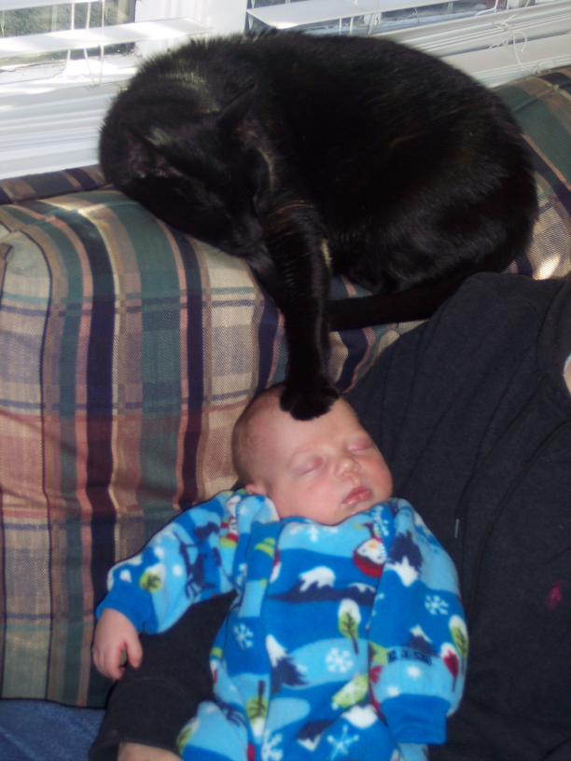
Cat Scratch Disease Diagnosis
Many are asymptomatic or have very mild symptoms
LAD (90%) develops in ~2 weeks
Fever (33%), headache, fatigue, and a poor appetite
Splenomegally (12%, 50% children)
Rare: bacillary angiomatosis and Parinaud's oculoglandular syndrome (2-3%)
Immunocompromised patients at highest risk

Slide 24
Cat Scratch Disease – Treatment (Humans)
Most self-limited
(5-14% can disseminate to liver, spleen, or eye if untreated)
Treat all symptomatic patients (SOR IIB)
Azithromycin: 500mg x1, then 250mg qd x4
(10mg/kg x1, then 5mg/kg qd x4)
Clarithromycin: 500mg BID
(15-20mg/kg divided BID)
Rifampin: 300mg BID
(10mg/kg divided BID)
Trimethoprime-sulfamethoxazole: DS BID
(8/40 mg/kg divided BID)
Ciprofloxacin 500mg BID
Jarisch-Herxheimer reaction can happen
Rolain, JM, Brouqui, P, Koehler, JE, et al. Recommendations for treatment of human infections caused by Bartonella species. Antimicrob Agents Chemother 2004; 48:1921.
Spach, D and Kaplan, S. Treatment of cat scratch disease. Uptodate.com (v15.2) 8/7/07.

Slide 25
Cat Scratch Disease – Treatment (Humans)
Reaction to endotoxin-like products released by the death of harmful microorganisms during antibiotic treatment.
Symptoms: fever, chills, headache, tachycardia, hypotension, myalgia, flushing
Classically seen in treatment of syphilis
Most self-limited
(5-14% can disseminate to liver, spleen, or eye if untreated)
Treat all symptomatic patients (SOR IIB)
Azithromycin: 500mg x1, then 250mg qd x4
(10mg/kg x1, then 5mg/kg qd x4)
Clarithromycin: 500mg BID
(15-20mg/kg divided BID)
Rifampin: 300mg BID
(10mg/kg divided BID)
Trimethoprime-sulfamethoxazole: DS BID
(8/40 mg/kg divided BID)
Ciprofloxacin 500mg BID
Jarisch-Herxheimer reaction can happen
Rolain, JM, Brouqui, P, Koehler, JE, et al. Recommendations for treatment of human infections caused by Bartonella species. Antimicrob Agents Chemother 2004; 48:1921.
Spach, D and Kaplan, S. Treatment of cat scratch disease. Uptodate.com (v15.2) 8/7/07.

Slide 26
Cat scratch disease Animal Infections
Cats
Usually asymptomatic
Fever, anorexia, non-specific
Diagnosis
Serology only indicates past exposure
Blood and tissue culture (expensive)
Treatment
Difficult
1st line: Doxycycline administered at 10 mg/kg, PO, q12–24 h or amoxicillin–clavulanate at 22 mg/kg, PO, q12 h for 7 days
If not improving: azithromycin (10 mg/kg, PO, daily for 1 week followed by q48 h) or a fluoroquinolone
Brunt J, et al. American Association of Feline Practitioners 2006 Panel report on diagnosis, treatment and prevention of Bartonella spp. Infections. Vet Sci 8(4) 213-226. 2006

Slide 27
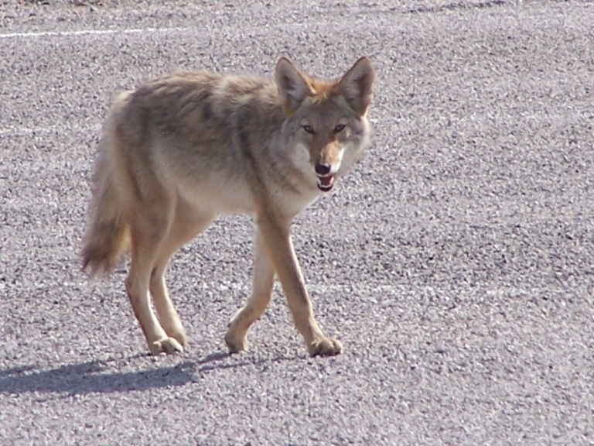
Cat Scratch Disease Animals
Dogs
Usually tick transition
Coyote reservoir
Usually different type of Bartonella
Symptoms: non-specific
Fever, polyarthritis, endocarditis, hepatitis
Diagnosis:
Serology is more helpful; neg does not rule out
PCR best test
Treatment:
Doxycycline and azithromycin

Slide 28
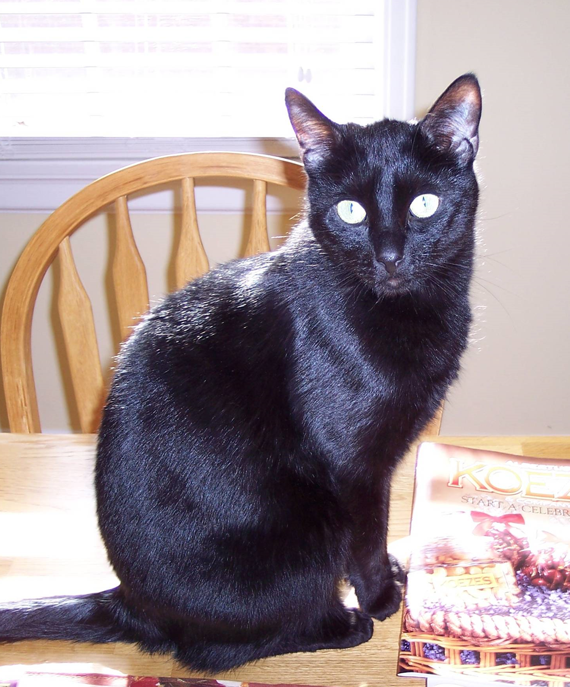
Cat Scratch Disease Prevention
Avoid "rough play" with cats
Immediately Wash cat bites and scratches
Control fleas!

Slide 29
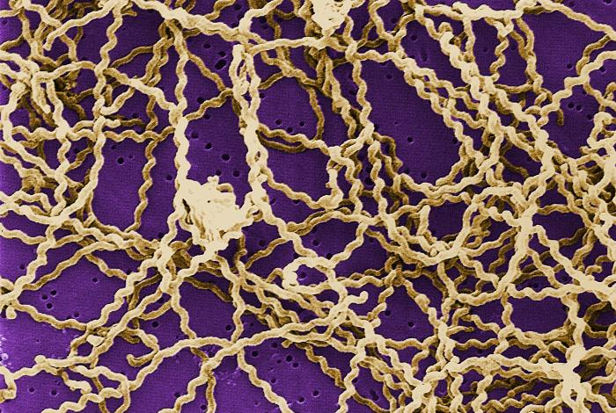
Leptospirosis
Long, thin motile spirochetes
100-200 cases annually in the US
(about half the human cases in Hawaii)
Reinstated as a nationally notifiable disease in 2013
Direct transmission between mammals
Indirect transmission via contact with Leptospira contaminated water or soil
Outbreaks and sporadic cases
May be associated with floods
Photo courtesy CDC/ Rob Weyant, no copyright.

Slide 30
Leptospirosis
Clinical Manifestation
Incubation period ~7 days (2-29)
Fever, headache, chills, myalgias, vomiting, jaundice, anemia, and sometimes a rash
Conjunctival suffusion.
If untreated, can develop kidney damage, meningitis, liver failure, and respiratory distress, and death (1-5%)
Serious icteric form (Weil's disease)
Diagnosis
Dark field microscopic agglutination test (MAT)
Leptospira-specific IgM (sensitive and specific)
Usually acquired from contaminated water sources such as streams and lakes.

Slide 31
Leptospirosis
Clinical Manifestation
Incubation period ~7 days (2-29)
Fever, headache, chills, myalgias, vomiting, jaundice, anemia, and sometimes a rash
Conjunctival suffusion.
If untreated, can develop kidney damage, meningitis, liver failure, and respiratory distress, and death (1-5%)
Serious icteric form (Weil's disease)
Diagnosis
Dark field microscopic agglutination test (MAT)
Leptospira-specific IgM (sensitive and specific)
Usually acquired from contaminated water sources such as streams and lakes.
Dark field microscopy rarely done.

Slide 32
Leptospirosis – Animals
Classically: Liver and renal failure
Dog:
Any with unknown renal failure should be considered
Fever and muscle tenderness/reluctance to move early in infection
Uveitis, conjunctivitis
Respiratory distress and leptospiral pulmonary hemorrhage syndrome (LPHS)
Horses: can cause acute renal failure, abortion, uveitis

Slide 33
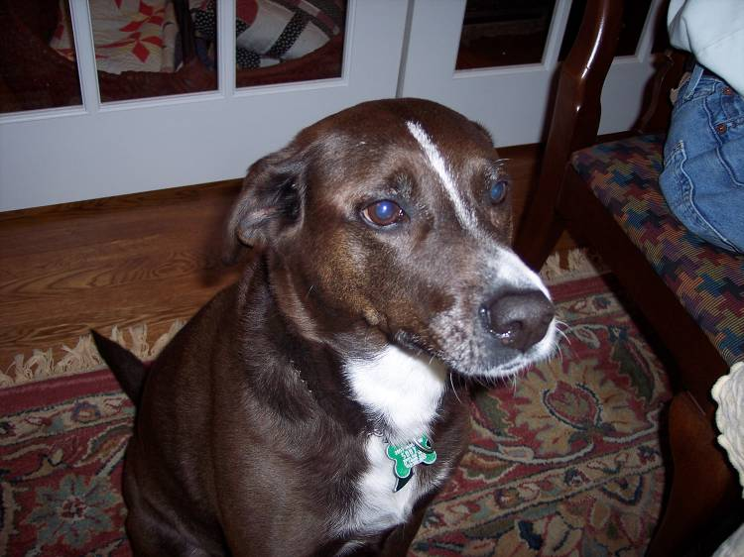
Leptospirosis Humans
Treatment
Most self limited
Treat all symptomatic patients (SOR IIB)
Doxycycline 100 mg PO twice daily
(shortened illness by 2 days, prevents urine shedding)
Ceftriaxone 1 g every 24 hours
Penicillin 6 million units daily
Suputtamongkol, Y, Niwattayakul, K, Suttinont, C, et al. An open, randomized, controlled trial of penicillin, doxycycline, and cefotaxime for patients with severe leptospirosis. Clin Infect Dis 2004; 39:1417.
Everett, ED. Treatment and prevention of leptospirosis. Uptodate.com
Takafuji, ET, Kirkpatrick, JW, Miller, RN, et al. An efficacy trial of doxycycline chemoprophylaxis against leptospirosis. N Engl J Med 1984; 310:497.

Slide 34
Leptospirosis Humans
Treatment
Most self limited
Treat all symptomatic patients (SOR IIB)
Doxycycline 100 mg PO twice daily
(shortened illness by 2 days, prevents urine shedding)
Ceftriaxone 1 g every 24 hours
Penicillin 6 million units daily
Due to the potential for severe complications.
Suputtamongkol, Y, Niwattayakul, K, Suttinont, C, et al. An open, randomized, controlled trial of penicillin, doxycycline, and cefotaxime for patients with severe leptospirosis. Clin Infect Dis 2004; 39:1417.
Everett, ED. Treatment and prevention of leptospirosis. Uptodate.com
Takafuji, ET, Kirkpatrick, JW, Miller, RN, et al. An efficacy trial of doxycycline chemoprophylaxis against leptospirosis. N Engl J Med 1984; 310:497.

Slide 35
Leptospirosis Animals (Dogs)
Treatment
doxycycline 5 mg/kg PO or IV q12h for 2 weeks
If vomiting precludes doxycycline:
ampicillin, 20 mg/kg IV q6h
Followed by doxycycline for 2 weeks after GI symptoms improve
Consider intermittent hemodialysis or continuous renal replacement therapy for severe uremia
Owner Education
Avoid contact with urine and clean contaminated surfaces with household disinfectants
Keep infected dog from urinating in standing water
Skyes J, et al. 2010 ACMIM small animal concensus statement on Leptospirosis: diagnosis, epidemiology, treatment, and prevention. J Vet Intern Med. 2011 Jan; 25(1): 1–13.

Slide 36
Leptospirosis
Prevention
Vaccinate Animals
Avoid stagnant or contaminated water for both humans and pets
Rodent control measures
Doxycycline prophylaxis
(200 mg qwk for 2-3 wks and at the end of exposure)
Suputtamongkol, Y, Niwattayakul, K, Suttinont, C, et al. An open, randomized, controlled trial of penicillin, doxycycline, and cefotaxime for patients with severe leptospirosis. Clin Infect Dis 2004; 39:1417.
Everett, ED. Treatment and prevention of leptospirosis.
Takafuji, ET, Kirkpatrick, JW, Miller, RN, et al. An efficacy trial of doxycycline chemoprophylaxis against leptospirosis. N Engl J Med 1984; 310:497.
Skyes J, et al. 2010 ACMIM small animal concensus statement on Leptospirosis: diagnosis, epidemiology, treatment, and prevention. J Vet Intern Med. 2011 Jan; 25(1): 1–13.

Slide 37
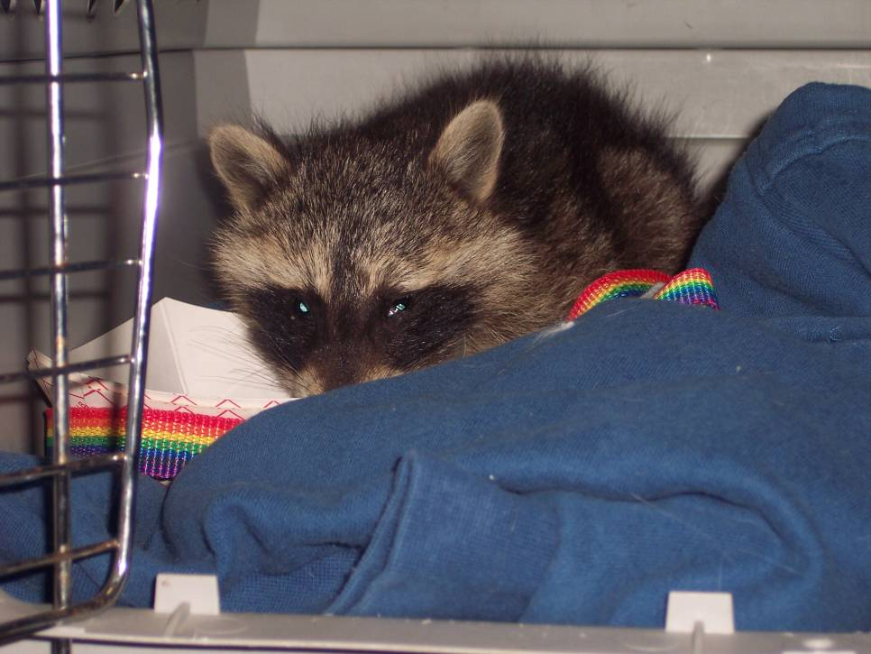
Worms
Baylisascaris procyonis
Raccoon round worm
Often fatal
severe CNS disease
Ocular larva migrans
Avoid contact with raccoons
Have a professional get rid of raccoons and clean up raccoon latrines.

Slide 38
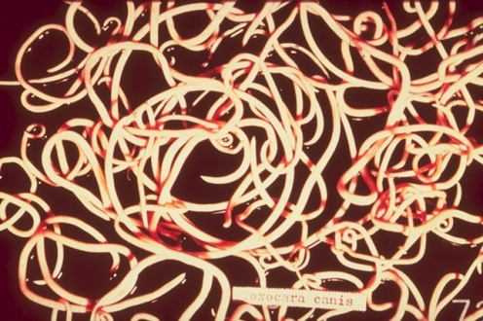
Toxocariasis (Roundworms)
Dogs (Toxocara canis), Cats (T. cati)
10,000 human cases annually in U.S.
20% of adult dogs, 80% of puppies are infected
Human infection
Eggs are not initially infective (2-4 wks in soil)
Children 1-5 highest risk
Severe: Malaise, irritability,
fever, hepatomegaly, pruritic
cutaneous lesions, respiratory
symptoms

Slide 39
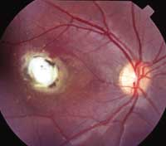
Toxocariasis Ocular, visceral, or cutaneous larva migrans
Ocular larva migrans
Causes inflammation and scarring of the retina
700 people per year experience permanent partial loss of vision.
Symptoms: Strabismus and failing vision

Slide 40
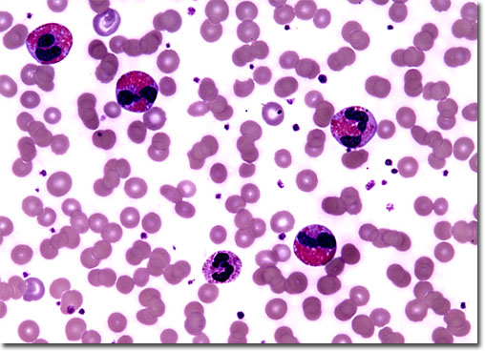
Toxocariasis
Diagnosis
Leukocytosis with eosinophilia
ELISA antibody assay (not good for OLM)
Tissue biopsy (rarely done)
Stool studies in animals

Slide 41
Toxocariasis
Treatment
Humans
Self limited
Severe cases:
Albendazole 400mg BID
Mebendazole 100-200mg BID
Animals
Drugs approved for treatment of Toxocara infections in dogs and cats are fenbendazole, milbemycin oxime, moxidectin, selamectin (T. cati only), piperazine, and pyrantel pamoate
Puppies and kittens should be routinely dewormed at 2, 4, 6, and 8 weeks of age
Lee A, et al. Epidemiologic and zoonotic aspects of ascarid infections in dogs and cats. Trends Parasitol 26 (4) 2010. 155-161.

Slide 42
Toxocariasis
Most worms are fecal oral transmission
Prevention
Regular veterinary care
Wash your hands after playing outside or with pets
Do not allow children to play in areas that may be soiled with pet or other animal stool.
Clean your pet's living area at least once a week.
Avoid uncovered sand boxes.
Wash hands immediately after use of a sand box and keep child's hand out of their mouth while playing in the sand or dirt.
Teach children not to eat dirt or soil (Pica)

Slide 43
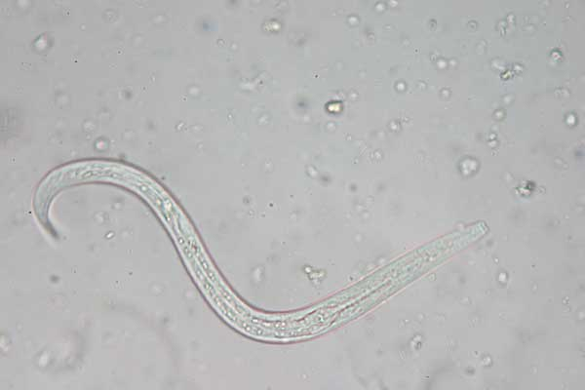
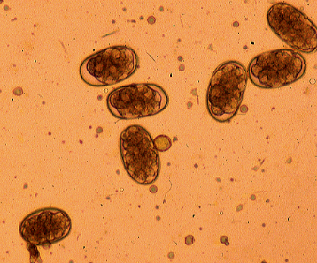
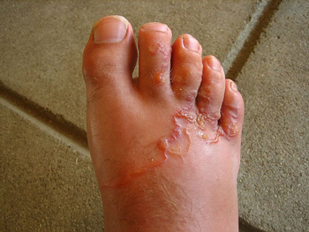
Hookworm
Ancylostoma caninum
Cutaneous larva migrans/Eosinophilic enteritis
Animals: anemia, GI signs, cutaneous larva migrans (hookworm dermatitis), respiratory illness

Slide 44
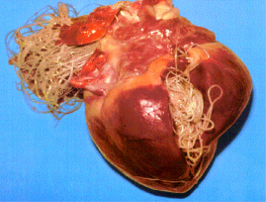
Worm Prevention
Use your heartworm meds to prevent other worms!

Slide 45
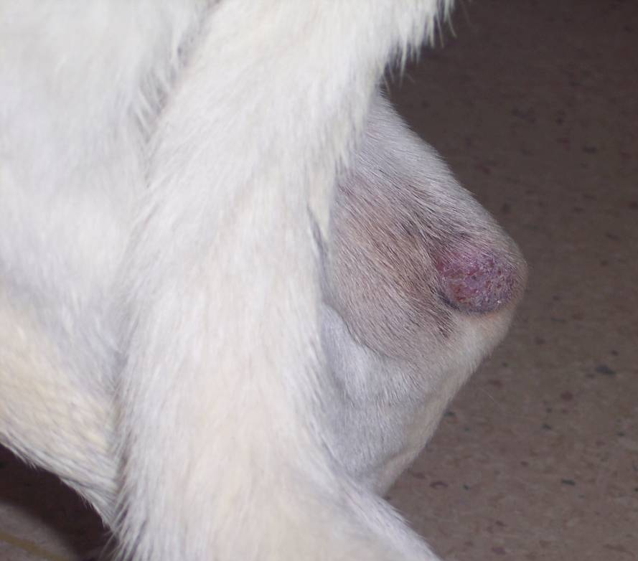
Tinea and pets (Ringworm)
Caused by a fungus, not a “worm”
Can be transmitted by pets
Can be given to pets by people
Infected animals almost always symptomatic
Persian cats and Yorkshire Terriers can be frequent asymptomatic carriers

Slide 46
Tinea and pets
Tinea is everywhere in our environment
Most human infections are not caused by pets.
More likely to get it from the gym or a child’s school
Active infections in animals causes areas of alopecia
Treatment in animals is often long and expensive
Bottom Line: If your pet is not symptomatic, you probably didn’t get it from the pet, and the pet does not need treatment!

Slide 47
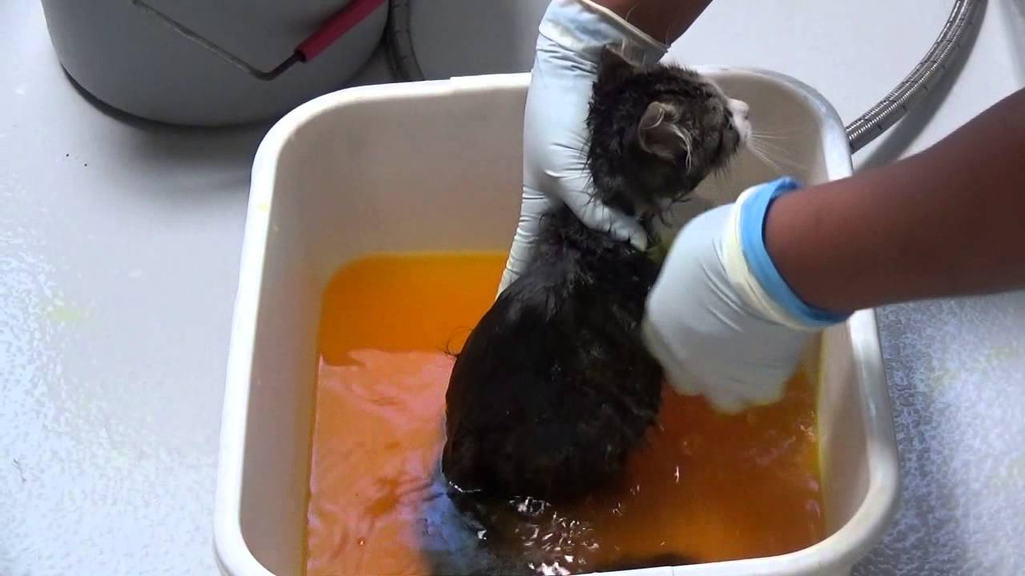
Tinea Treatment
Humans
Skin: Topical antifungals
Scalp: Oral antifungals (Griseofulvin)
Animals
Definitive diagnosis based on culture/histopath as many things can cause alopecia and look similar to tinea
Need for systemic therapy
Topical treatment is not adequate; is palliative at best
6-10 weeks of treatment
(up to 6 months in long haired breeds)

Slide 48
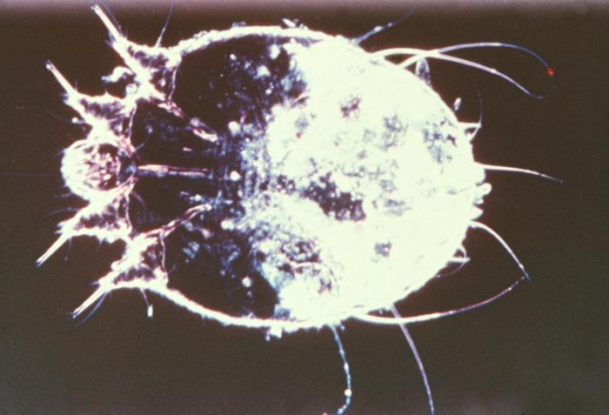
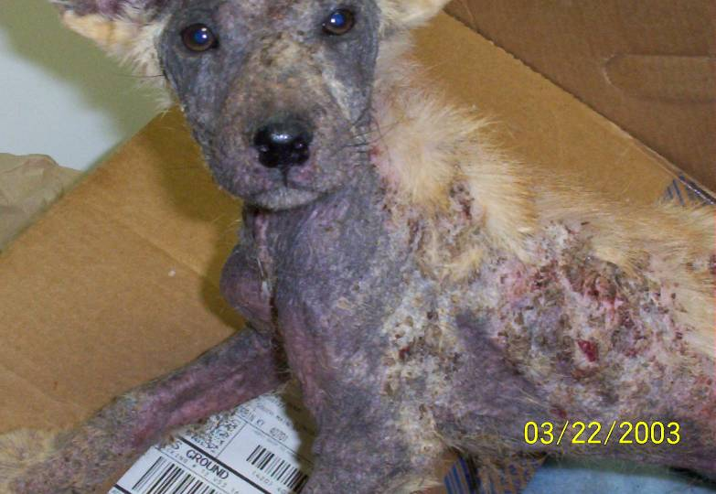
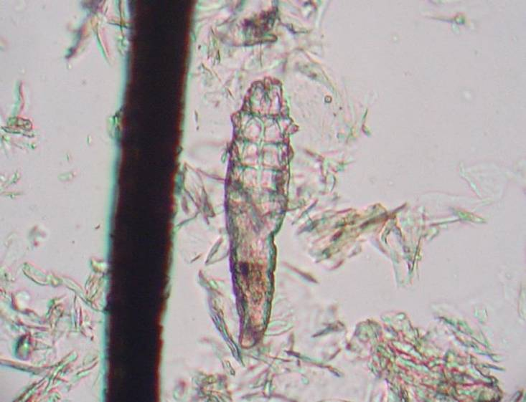
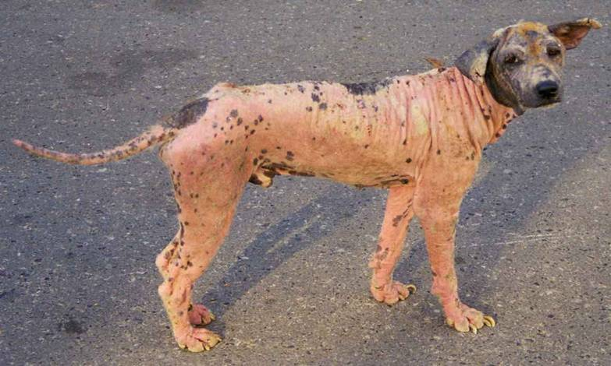
Mites (Mange) Sarcoptes vs Demodex
Sarcoptes
(Scabies)
is zoonotic
Demodex
is not zoonotic
Courtesy CDC/Joe Miller/Reed and Crnrick pharmaceuticals. , no copyright
Courtesy Joel Mills, GNU Free Documentation License

Slide 49
Mites (Mange) Sarcoptes vs Demodex
Microscopic exam is the only way to differentiate.
Physicians can contact the veterinarian if there is a question about which was diagnosed.
Veterinarians should offer to contact the physician of a client whose pet has been diagnosed with sarcoptes.
Sarcoptes
(Scabies)
is zoonotic
Demodex
is not zoonotic
Courtesy CDC/Joe Miller/Reed and Crnrick pharmaceuticals. , no copyright
Courtesy Joel Mills, GNU Free Documentation License

Slide 50
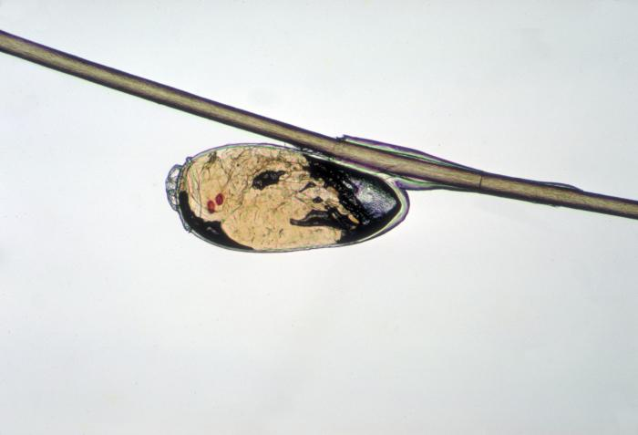
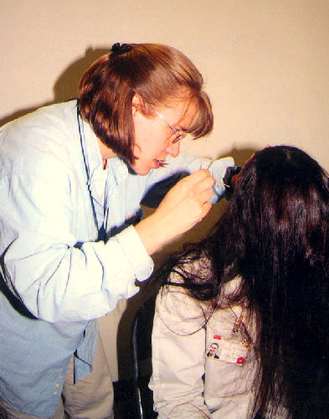
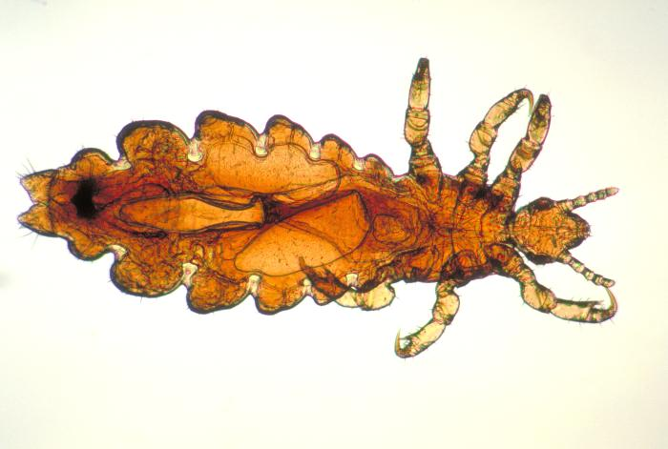
LICE IS SPECIES SPECIFIC (Not a Zoonotic Infection)
Courtesy CDC/Dr. Dennis D. Juranek, No copyright.
Courtesy CDC/Dr. Rachel Barwick, no copyright.

Slide 51
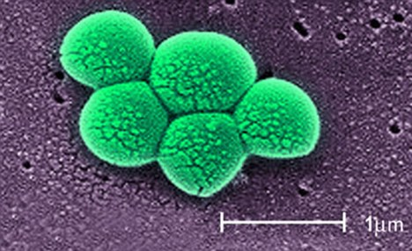
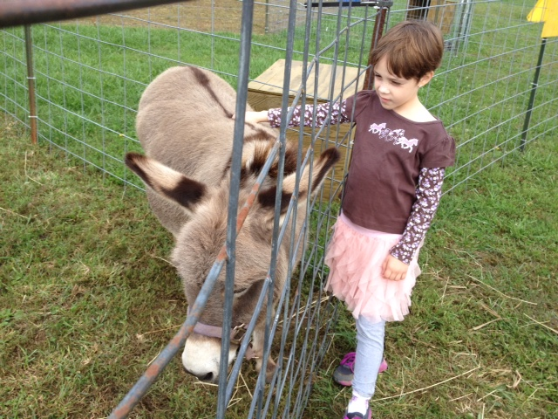
MRSA
Well documented in domestic animals.
Originated in people.
Increasing in prevalence.
Horses
Cats and dogs
van Duijkeren E, Wolfhagen MJHM, Box ATA, Heck MEOC, Wannet WJB, Fluit AC. Human-to-dog transmission of methicillin-resistant Staphylococcus aureus. Emerg Infect Dis [serial on the Internet]. 2004 Dec.
Methicillin-Resistant Staphylococcus aureus in Horses and Horse Personel, Emerg Infec Dis, (11:3), Mar. 2005.

Slide 52
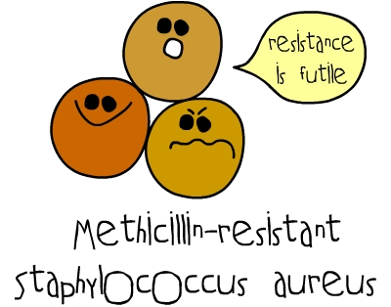
MRSA
Diagnosis
Easily cultured
Treatment
Susceptibilities will guide treatment
Sulfa, clindamycin, doxycycline, chloramphenicol
Prevention
GOOD HAND WASHING!

Slide 53
Case 1
A man was admitted to the hospital with pneumonia. It was originally misidentified by as Pseudomonas luteola by an automated lab system.
The man deteriorated and was transferred to a referral hospital and diagnosed with Yersinia pestis.
Upon investigation the man had a dog that recently died with hemoptysis. The dog, a male pit bull terrier aged 2 years, became ill with fever, jaw rigidity, drooling, and right forelimb ataxia. After being hospitalized overnight the dog was euthanized after developing dyspnea and bloody sputum. It was negative for rabies and anticoagulants. After contact with the health department liver and lung tissue from the dog were tested and found to be positive.
2 veterinary clinic employees and a close contact to the man had respiratory symptoms and tested positive for Yersinia pestis.
114 persons had close contact with the dog or one or more of the human patients: 36 in veterinary settings, 58 in human health care settings, and 20 as close personal contacts. 88 of them were recommended to take antibiotic prophylaxis

Slide 54
Case 1 Questions
From a One Health aspect, what parts to this case went well?
How could health professionals have worked better together in this case to prevent further spread of the disease?

Slide 55
Case 2
In 2015 California had a record number of deaths from West Nile virus. (all but 3 of the deaths were in Southern California)
45 deaths and 737 cases.
These were by far the most in the US
The virus is spread by mosquitoes and has killed many birds as well.

Slide 56
Case 2 Questions
What are Veterinarians, Physicians, and health professionals role in the detection and prevention of West Nile?
How can they work together to decrease the spread of West Nile virus?

Slide 57
Summary
Pets can transmit infections to people
Simple precautions will minimize risk
Regular veterinary care is important to minimize risk, including regular vaccinations, flea and tick prevention, and heartworm prevention
NEVER trust The Cat In The Hat

