Slide 1
Pres. Elect Trump & the 115th Congress:
The legislative landscape for AVMA and AAVMC
Kevin Cain & Gina Luke
Dec. 16, 2016

Slide 2
Presidential politics - year of the outsider
Populist positions vs. liberal/conservative
Very little turnover despite unpopularity
Congested legislative calendar
Confirmation hearings and new team
FFYs 2017 and 2018 appropriations
Debt ceiling and sequestration
Notes:
115th Senate: 52 Republicans, 46 Democrats, 2 Independents
115th House: 239 Republicans, 194 Democrats, 2 TBD
Just 28 states sent at least one new member to Congress
There Dems picked up just 2 senate seats and 6 House seats.
Ambitious agenda to be pursued in the first session of the 115th Congress. First 6 months in the Senate will be largely devoted to confirmation hearings as well as tackling the budget and appropriations issues left unfinished by the 114th Congress.
The Senate is scheduled to be in session for 182 days while the House has scheduled 145 days in Washington. The two chambers will overlap on 139 days.

Slide 3
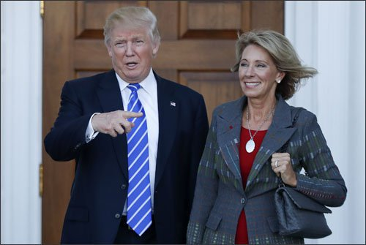
Pres. Elect Donald Trump, "If borrowers work hard and make their payments for 15 years, we'll let them get on with their lives." Oct. ’16
Trump received more questions about student debt than any other issue besides defense.
Nominated Ed Sec. Betsy DeVos has a sparse record on postsecondary education issues
Notes:
SHELP Chair Lamar Alexander (a former ED Secretary himself), called Betsy DeVos, an “excellent choice” to lead ED and SHELP will move swiftly to consider her nomination in January. Alexander looks forward to working with DeVos on HEA reauthorization , which he has called an opportunity to clear out a "jungle of red tape" in the sector. We can expect deregulation to be a major focus of DeVos although her record on postsecondary education is sparse.
She is a philanthropist and former chairwoman of the Michigan Republican Party (1996-2000) She and her husband have invested in Social Finance Inc., an online-lending company.
Also, the couple’s foundation has a history of supporting higher education institutions in Michigan through charitable contributions. Her primary involvement has been on K-12 issues – particularly school vouchers and charter schools – and she was a board member on JEB Bush’s Foundation for Excellence in Education. Expect her to continue pushing her pet causes since Trump has proposed creating a $20-B federal school voucher program.
Her father-in-law Richard DeVos, founder of Amway and owner of the Orlando Magic NBA team. He played a role in establishing Michigan State University's medical campus in Grand Rapids.

Slide 4
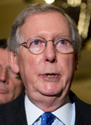
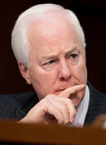
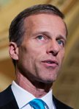
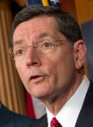
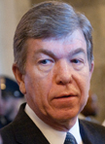
115th Senate Majority Leadership
2. John Cornyn (TX)
Republican Whip
3. John Thune (SD)
Republican Conference Chair
4. John Barrasso (WY)
Policy Committee Chair
Mitch McConnell (KY)
Leader
5. Roy Blunt (MO)
Republican Conference Vice Chair
6. Cory Gardner (CO)
National Republican Senatorial Committee Chair
Notes:
Senate Republican leader: Mitch McConnell (R-KY)
Senate Republican whip: John Cornyn (R-TX)
Senate Republican Conference chairman: John Thune (R-SD)
Senate Republican Policy Committee chairman: John Barrasso (R-WY)
Senate Republican Conference vice chairman: Roy Blunt (R-MO)
National Republican Senatorial Committee chairman: Cory Gardner (R-CO)

Slide 5
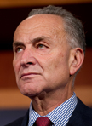
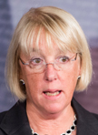
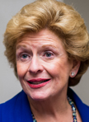
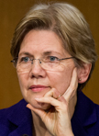
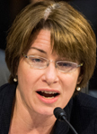
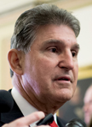
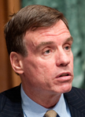
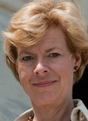
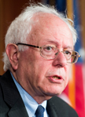
115th Senate Minority Leadership
2. Dick Durbin (IL)
Dem. Whip
3. Patty Murray (WA)
Asst. Dem. Leader
4. Debbie Stabenow (MI)
Chair, Dem. Policy & Communications Committee
5. Elizabeth Warren (MA)
Vice Chair of the Conference
1. Chuck Schumer (NY)
Minority Leader
7. Amy Klobuchar (MN)
Chair of Steering Committee
9. Joe Manchin (WV)
Vice Chair of the Dem. Policy & Communications Committee
6. Mark Warner (VA)
Vice Chair of the Conference
8. Bernie Sanders (VT)
Chair of Outreach
10. Tammy Baldwin (WI)
Dem. Conference Secretary
Notes:
Senate Democratic Leader and Chair of the Conference: Senator Charles Schumer
Democratic Whip: Senator Dick Durbin
Assistant Democratic Leader: Senator Patty Murray
Chair of the Democratic Policy and Communications Committee: Senator Debbie Stabenow
Vice Chair of the Conference: Senator Elizabeth Warren
Vice Chair of the Conference: Senator Mark Warner
Chair of Steering Committee: Senator Amy Klobuchar
Chair of Outreach: Senator Bernie Sanders
Vice Chair of the Democratic Policy and Communications Committee: Senator Joe Manchin
Senate Democratic Conference Secretary: Senator Tammy Baldwin

Slide 6
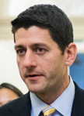
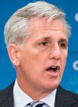
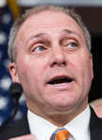
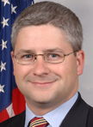
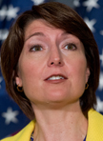
115th House Majority Leadership
2. Kevin McCarthy (CA)
Republican Leader
3. Steve Scalise (LA)
Republican Whip
4. Patrick McHenry (NC)
Chief Deputy Whip
1. Paul Ryan (WI)
Speaker of the House
5. Cathy McMorris Rogers (WA)
Caucus Vice-Chair
6. Luke Messer (IN)
Policy Chair
Notes:
Republican Steering Committee Total Votes 36 Quorum 19: (the 5 pictured, reps from NRCC, large/small states, regional:
Speaker: Paul Ryan; Republican Leader: Kevin McCarthy; Republican Whip: Steve Scalise; Chief Deputy Whip: Patrick McHenry; Republican Conference Chair: Cathy McMorris-Rodgers; Policy Chair: Luke Messer
Conference Vice-Chair: DOUG COLLINS; Conference Secretary: Jason Smith
NRCC Chairman (former): Greg Walden; NRCC Chairman: STEVE STIVERS
California Representative: Devin Nunes
Florida Representative: Vern Buchanan
Pennsylvania Representative: Bill Shuster
Ohio Representative: Pat Tiberi
Texas Representative I: Lamar Smith; Texas Representative II: JOHN CARTER
Region I Representative: TOM REED
Region II Representative: Bob Goodlatte
Region III Representative: Richard Hudson
Region IV Representative: Tom Graves
Region V Representative: Mike Rogers
Region VI Representative: John Shimkus
Region VII Representative: Fred Upton
Region VIII Representative: Steve Womack
Region IX Representative: Kevin Yoder
Region X Representative: TOM EMMER
Region XI Representative: DAVID SCHWEIKERT
Small State Representative: KEVIN CRAMER; 114th Class Representative: Steve Russell; 115th Class Representative: FRANCIS ROONEY; Speaker Designee: Susan Brooks

Slide 7
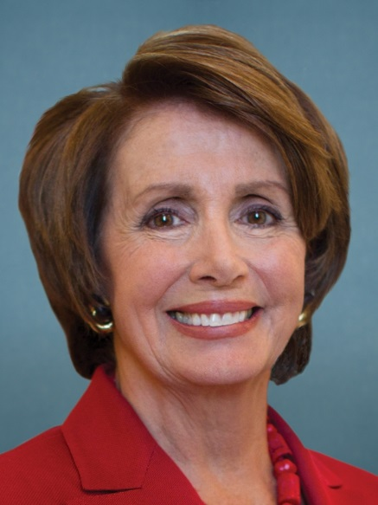
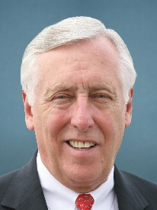
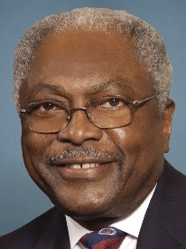
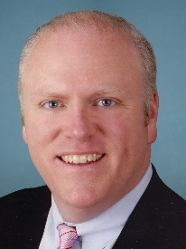
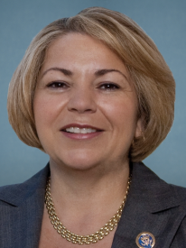
115th House Minority Leadership
2. Steny Hoyer (MD)
Minority Whip
3. James Clyburn (SC)
Assistant Minority Leader
1. Nancy Pelosi (CA)
House Minority Leader
4. Joe Crowley (NY)
Caucus Chair
4. Linda Sanchez (CA)
Caucus Vice-Chair
Notes:
D Leader: Nancy Pelosi
D Whip: Steny H. Hoyer
Assistant D Leader: James E. Clyburn
D Caucus Chair: Joseph Crowley
D Caucus Vice Chair: Linda T. Sánchez
D Steering & Policy Co-Chair: Rosa DeLauro
D Steering & Policy Co-Chair: Eric Swalwell
D Steering & Policy Vice Chair / Parliamentarian: Jared Polis
D Steering & Policy Vice Chair: Barbara Lee
Budget Committee Ranking Member: John Yarmuth
Freshman Leadership Rep: Colleen Hanabusa
Democratic Congressional Campaign Committee Chair: Ben Ray Lujan
Democratic Policy & Communications Committee Co-Chairs (3): Cheri Bustos, Hakeem Jeffries, David Cicilline
Caucus Leadership Rep. of 5 Terms or Less:

Slide 8
Notes:
ED is the smallest Cabinet agency with approximately 4,500 FTE. It has the 3rd largest discretionary appropriation.
DeVos is important but because she has minimal record on higher ed the appointment of the Under Secretary will be very important. This position coordinates policies, programs, and activities related to postsecondary education, career-technical education, adult education, and federal student aid.
ED provides aid to 12+ million students annually – approximately $100-B in new loans each year.
In 2016 there was a $1.2-T loan portfolio covering 41 million loan borrowers.
In 2016, 1 in 4 student loan borrowers were in default or struggling to repay their loans. This will surely be a central focus on the next administration.

Slide 9
115th Senate Committee on Health Education Labor & Pensions
Lamar Alexander (TN)
Chairman
Patty Murray (WA)
Ranking Member
Notes:
In the 114th Congress SHELP’s membership had 12 Republicans and 10 Democrats.
Chair: Lamar Alexander (R-TN)
Ranking: Patty Murray (D-WA)
The composition of the Committee may change in the 115th Congress.
Committee membership will be finalized in January.
HEA will be worked at the full committee level.

Slide 10
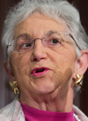
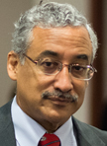
115th House Committee on Education & the Workforce
Virginia Foxx (NC-5)
Chairman
Bobby Scott (VA-3)
Ranking Member
Notes:
In the 114th Congress E&W’s membership had 22 Republicans and 16 Democrats.
The Committee’s composition may change going into the 115th Congress. Membership will be finalized in January.
NEW Chair: Virginia Foxx (R-NC)
Ranking: Robert Scott (D-VA)
Leading the committee’s work will be the Subc. on Higher Education and Workforce Training which will get a new chair and ranking member as Rep. Foxx will lead the full committee and the ranking member Rep. Ruben Hinojosa was defeated in Nov.

Slide 11
Guideposts for 115th Congress HEA
Senate Reauthorization Bills from 114th Congress:
Alexander’s Financial Aid Simplification and Transparency (FAST) Act
House Reauthorization bills from 114th Congress which passed in July 2016 and referred to the U.S. Senate:
Simplifying the Application for Student Aid Act
Strengthening Transparency in Higher Education Act
Empowering Students Through Enhanced Financial Counseling Act
Flexible Pell Grant for 21st Century Students Act
Notes:
The FAST Act (S. 108) was introduced by Chairman Alexander with bipartisan support. The bill would simplify the FASFA, reducing questions from 103 to 2. A significant change is proposed – discontinuing the Direct Loan Program and replacing it with a revised a single loan program under a repurposed part F of the HEA. Part F loans would have essentially parallel terms and conditions to Direct Unsubsidized Loans, and would be available to undergraduates, graduate-professional students, and parents or legal guardians of undergraduates. It makes no distinction between dependent or independent undergraduates, and eliminates differences in annual limits based on year in school. This new single loan program eliminates the existing Perkins Loan program. Eliminating subsidies would render the current need analysis unnecessary for this loan program. Student loans would be limited to cost minus grants and scholarships that the institution knows about, up to the applicable annual loan limit. Student loans would be included in estimated financial assistance when calculating the amount for parent loans. Schools could still reduce the amount of a student loan, or refuse to certify it altogether, under exceptional circumstances. Schools would still be responsible for determining the amount of the loan and setting disbursement schedules as currently defined.
The annual loan limit would be $8,000 for undergraduates and $30,000 for graduate or professional students, but a provision is made for an institution to allow higher graduate/professional annual limits for students in programs with high need up to a 50 percent increase in their aggregate limitations. The undergraduate aggregate limit would be $37,500; the graduate/professional aggregate limit would be $150,000, which would not include any undergraduate loans.
Repayment would begin after a 6-month grace period. ED would be required to provide information about the two repayment options available to the borrower: the income-based repayment plan and a 10-year plan with fixed monthly payments.
Simplifying the Application for Student Aid Act (H.R. 3177) was introduced by Reps. Denny Heck (D-WA), Phil Roe (R-TN), Jared Polis (D-CO) and Mark Pocan (D-WI). It would require the ED to use Prior Prior Year (PPY) in the federal need analysis. The use of PPY would offer more time for students and families to evaluate award offers from institutions and make an informed decision about where to attend college, and could also enhance use of the IRS’s Data Retrieval Tool (IRS-DRT). This tool simplifies the application process and decreases the burden of income verification.
Empowering Students Through Enhanced Financial Counseling Act (H.R. 3179) was introduced by Reps. Brett Guthrie (R-KY), Rick Allen (R-GA), and Suzanne Bonamici (D-OR). It would promote financial literacy by requiring annual loan counseling for all recipients of federal financial aid (student loan borrowers, Federal Pell Grant recipients and parent PLUS Loan borrowers). Enhanced counseling would include comprehensive information on the terms, conditions, and responsibilities with respect to a grant or loan and general information on a typical student budget, the right to request an annual credit report, average income and employment data, and financial management resources. The bill revises, expands, or establishes specific annual counseling information requirements for student borrowers, Pell Grant recipients, or parent PLUS Loan borrowers. It revises and expands exit counseling information requirements to include an outstanding loan balance summary, the anticipated monthly payments under standard and income-based repayment plans, an explanation of the grace period preceding repayment, the option to pay accrued interest before it capitalizes, the right to request an annual credit report, and loan servicer contact information. It directs ED to maintain a consumer-tested online counseling tool that provides annual and exit counseling.
Strengthening Transparency in Higher Education Act (H.R. 3178) was introduced by Reps. Virginia Foxx (R-NC), Luke Messer (R-IN) and Gregorio Sablan (D-Northern Mariana Islands). It would eliminate the College Navigator and its associated affordability and transparency lists and state higher education charts released by ED. In its place would be a College Dashboard Website, which would be developed and maintained by ED. The Dashboard would overhaul the type of data that the federal government publishes about colleges so that prospective students have better access to the facts they need to make an informed decision about where to enroll.
Flexible Pell Grant for 21st Century Students Act (H.R. 3180) was introduced by Reps. Elise Stefanik (R-NY), Carlos Curbelo (R-FL), and Ruben Hinojosa (D-TX), would permit students to receive additional Federal Pell Grant during an award year beginning on or after July 1, 2017, in order to accelerate their progress towards their program credential. Under this bill, a student could receive up to 150% of his or her Scheduled Award during an award year.

Slide 12
AVMA & AAVMC HEA issues
Ed Loans – affordability (interest rates, fees), access, income driven repayment plans, PSLF, financial literacy & counseling
Accreditation – GOP concerns about what it costs institutions to pursue and keep accreditation. Accreditation conveys a range of benefits including serving as a gateway to federal financial aid programs
Regulatory reform & Gainful Employment
Notes:
Each time I’ve been with Rep. Foxx she has spoken about the need to focus on affordability, accountability, and transparency in higher education. These issues will dominate her thinking as she works to reauthorized HEA. She was the author last session of The Supporting Academic Freedom through Regulatory Relief Act which sought to --
Repeal Gainful Employment regs, which levy reporting burdens on community and proprietary colleges and force administrators to seek federal approval before creating programs.
Repeal state authorization regulation, which forces states to follow federal requirements when deciding whether to grant an institution – including those offering online education programs – permission to operate within the state.
Repeal the credit hour regulation, which establishes a federal definition of a credit hour and increases the government’s control over institutions’ academic affairs.
Amends the incentive compensation regulation to ensure third-party service providers are allowed to enter into tuition sharing agreements with nonprofit colleges and universities to aid in the development of distance education platforms, and
Prohibits ED from issuing related regulations until after Congress reauthorizes HEA.

Slide 13
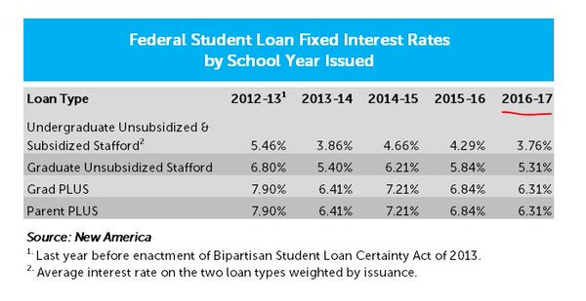
Student loan interest rates

Slide 14
Important non-HEA issues for 115th Congress
Animal drug compounding legislation
Pursuing federal legislation in early 2017
Will impact pharmacists and veterinarians who compound using FDA-approved drug products and bulk drug substances
Will impact ability to obtain, maintain, and dispense from office stock
FDA’s draft Guidance for Industry #230

Slide 15
Important non-HEA issues for 115th Congress
Farm Bill 2018
Ag research community draft proposal to streamline USDA’s science leadership
NIFA Director (combine Director of NIFA & REE Undersecretary) to: 1) Report directly to Ag Secretary; 2) Serve as USDA’s Chief Scientist; and 3) Oversee all USDA research activities. Reporting to the Director: AFRI Administrator (Extramural); ARS Administrator (Intramural); Education & Extension Administrator; and Capacity Grants Administrator.
Chief Economist: 1) Report directly to Ag Secretary; 2) Oversee ERS and NASS, to improve the quantity and quality of USDA Research.
Seek authorization of $1.4-B (adjusted annually for inflation). Research $ from discretionary and mandatory accounts. The first $750-M for AFRI would come from discretionary funding; all additional funding (up to the authorized level) would come from the mandatory budget.
Improve the AFRI RFP and peer review process.
Equalize indirect cost rates with other federal science programs to enable broader participation and sustainably address infrastructural issues.
Eliminate matching requirements for non-land grant institutions.
Encourage public/private research collaboration with guidelines to ensure public availability of intellectual property.
Commodity and Ag stakeholders draft proposal may seek mandatory funds of the Commodity Credit Corp for: 1) NAHLN; 2) a new National Vaccine Bank to include FMD; and 3) a new Animal Disease and Disaster Prevention Program to support activities to prevent, detect, and mitigate animal pests and diseases.
APLU may seek to condense budget lines and address $8.4-B in infrastructure needs
Notes:
Ag research community draft proposal would seek to: “empower and Streamline the USDA Science Leadership”. Modeled after the NIH Director, the NIFA Director would replace current leadership (combine Director of NIFA and Undersecretary for REE). NIFA Director would: 1) Report directly to the Ag Secretary; 2) Serve as USDA’s Chief Scientist; and 3) Oversee all USDA research activities (AFRI, ARS, ag research at HBCUs, etc.). Reporting to the Director of NIFA would be: AFRI Administrator (Extramural); ARS Administrator (Intramural); Education & Extension Administrator; and Capacity Grants Administrator. NOTE: This change would enable the creation of a USDA Undersecretary for Trade and Foreign Ag Affairs, a role established as part of the 2014 Farm Bill and supported by many commodity agricultural stakeholders. The Chief Economist would: 1) Report directly to the Ag Secretary; 2) Oversee ERS and NASS, to improve the quantity and quality of USDA Research. 3) The community would seek authorization of $1.4-B to be adjusted on an annual basis for inflation. Work closely with the agriculture committees, appropriations committees, and commodity groups to establish language wherein research dollars would come from both discretionary and mandatory accounts. A) Through a “trigger” provision, the first $750-M for AFRI would come from discretionary funding and all additional funding (up to the authorized level) would come from the mandatory budget. 2) Any subsequent rescission of discretionary funding would not affect the mandatory account. Mandatory research funding would not exceed 1% of Title 1 authorization. Improve the AFRI RFP and peer review process to ensure cutting edge science. Equalize indirect cost rates with other federal science programs to enable broader participation and sustainably address infrastructural issues. Provide dedicated staff for AFRI. Eliminate matching requirements for non-land grant institutions . Encourage public/private research collaboration with guidelines to ensure public availability of intellectual property.
An agriculture community draft proposal would seek mandatory funds of the Commodity Credit Corp for: 1) NAHLN; 2) a new National Vaccine Bank to include FMD and sufficient amounts of animal vaccine, antiviral, or therapeutic products to appropriately respond to the most damaging animal diseases affecting human health or the economy and that will be capable of deployment within 24 hours of an outbreak; and Animal Disease and Disaster Prevention Program to address problems resulting from the globalization of animal agriculture. The program would support activities to prevent, detect, and mitigate animal pests and diseases.

Slide 16
Important non-HEA issues for 115th Congress
Appropriations priorities – unchanged from previous years
NIH
Antimicrobial resistance - CARB initiative
USDA REE – 1433, VMLRP, VSGP, FADI, AFRI, etc.
USDA ARS, APHIS, NAHLN, etc.
FDA CVM – NARMS
NBAF – workforce readiness / training / education
Overall Tax Reform
VMLRP exemption from withholding taxes
Exclusion for employer-provided ed assistance to include payments of ed loans paid to either an employee or a lender
Student Loan Interest Deduction
Notes:
The VMLRP Enhancement Act will be reintroduced to exempt awards from a 39% withholding tax. (Mike Crapo / Adrian Smith)
Employer Participation in Student Loan Assistance Act will likely be reintroduced to extend the tax exclusion for employer-provided educational assistance to include payments of education loans paid to either an employee or a lender. Employers would be permitted to put as much as $5,500/year pretax towards an employee’s student loans. (Rodney Davis, R-IL-13, Sen. Mark Warner, D-VA.
Expanding Student Loan Interest Deduction may be reintroduced – not sure who will take over the bill now that the longtime sponsor (Rangel) retired. The bill would increase the maximum tax deduction from $2,500 to $5,000 for individuals ($10,000 for joint filers). It repeals the income-based phase-outs of $65,000 for individuals ($130,000 for joint filers) in the current deduction.

