Slide 1

Remediation Part 2: Putting it all together and making it happen
Emma Read, DVM, MVSc, DACVS
Associate Dean for Professional Programs
The Ohio State University College of Veterinary Medicine
Notes:
Welcome
Thank you

Slide 2

Acknowledgements
Remediation takes a village!
Everyone has a role to play
COVE members will help to lead these sessions
Part 1:
April Kedrowicz
Jessica Meekins
Jody Frost
Part 2:
Everyone

Slide 3
Reminder of Best Practices - Handout
Shearer C, Bosma M, Bergin F, Sargeant J, Warren A. 2019. Remediation in Canadian Medical Residency Programs: Established and emerging best practices. Med Teach 41(1): 28-35
Support from Administration
Mandatory rather than ‘suggested’ participation for struggling learners
Informed by multi-source data – preclinical and clinical. ITERs=major source of information and confirmed with detailed review of underlying competency issues
Individual remediation plans developed collaboratively – faculty working with administration
Frequent monitoring and documentation of progress – positive and negative
Development of longitudinal faculty-student relationships
Using variety of remediation methods to address issues
Tailor remediation plan for individual needs
Explicit mention of attitudes and motivation
Teaching goal setting, strategic planning, self-monitoring, and self-analysis
Emotional support, alongside rigorous, clear expectations
Faculty development in mentoring, facilitation, direct observation and feedback

Slide 4
We are going to make it happen!
Split into 3 groups - 1, 2, 3
COVE members will come and help you
ITER 1 - Small Animal Emergency Rotation – End of Final Year
ITER 2 - Small Animal Soft Tissue Surgery Rotation – Start of Final Year
ITER 3 - Small Animal Critical Care Rotation – Mid-Year

Slide 5
Questions to answer
What is going on? (problem list)
What is your plan for this student?
Who needs to be involved?
Are there any special considerations?

Slide 6
ITER 1

Slide 7
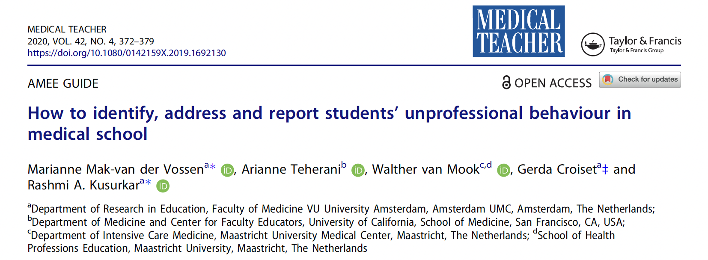
ITER 1 - Professionalism

Slide 8
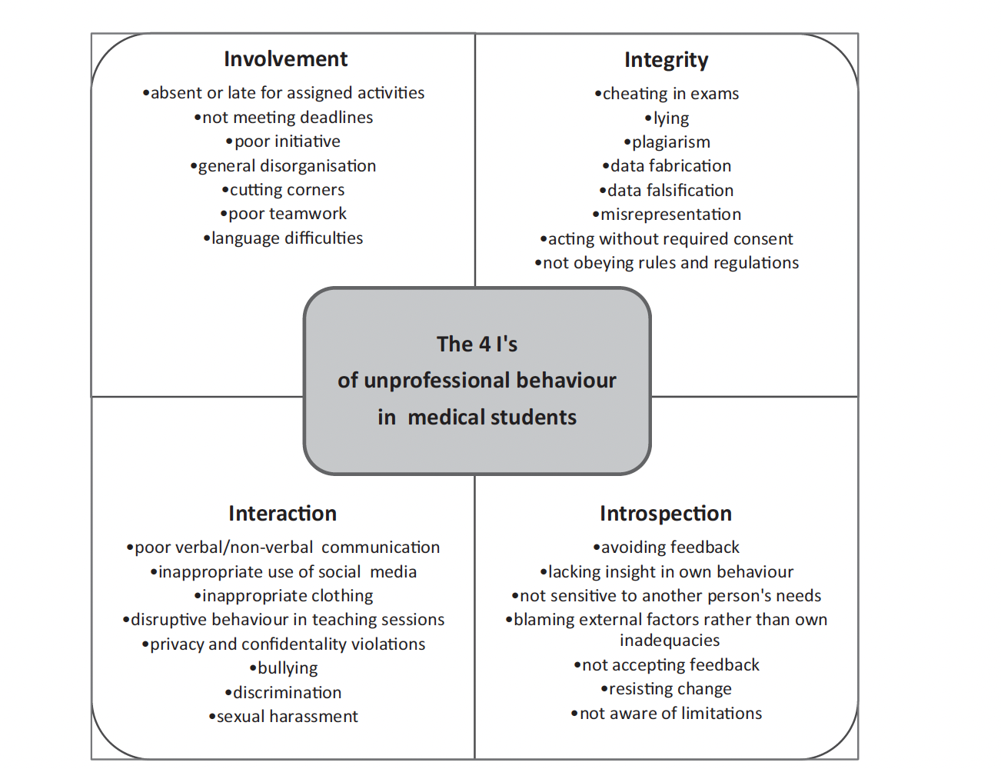
ITER 1 - Professionalism
Mak-van der Vossen et al, 2020

Slide 9
Remedial Assignment
10 Questions for the learner:
What happened?
Do you agree with the unprofessionalism judgement? (ITER)
What did you intend?
What did you expect would happen next?
What circumstances influenced your behavior?
Were you able to influence those circumstances?
What do you think your behavior did to others?
How do you feel about it now?
Are there any circumstances that make it more difficult for you to comply than others?
How will you act when in a similar circumstance next time?
Mak-van der Vossen et al, 2020

Slide 10
ITER 2

Slide 11

ITER 2 - Clinical Skills and Executive Functioning
39 described executive functions
3 most commonly referenced:
Self Control - Focus one’s attention, automatic behavior, responses, thoughts, and emotions without distraction
Working Memory - Keep information in mind and work with it
Cognitive flexibility - Adapt to a changed situation
Combining these core “lower-order” processes creates “higher order” or complex processes such as planning, reasoning, and problem-solving.

Slide 12
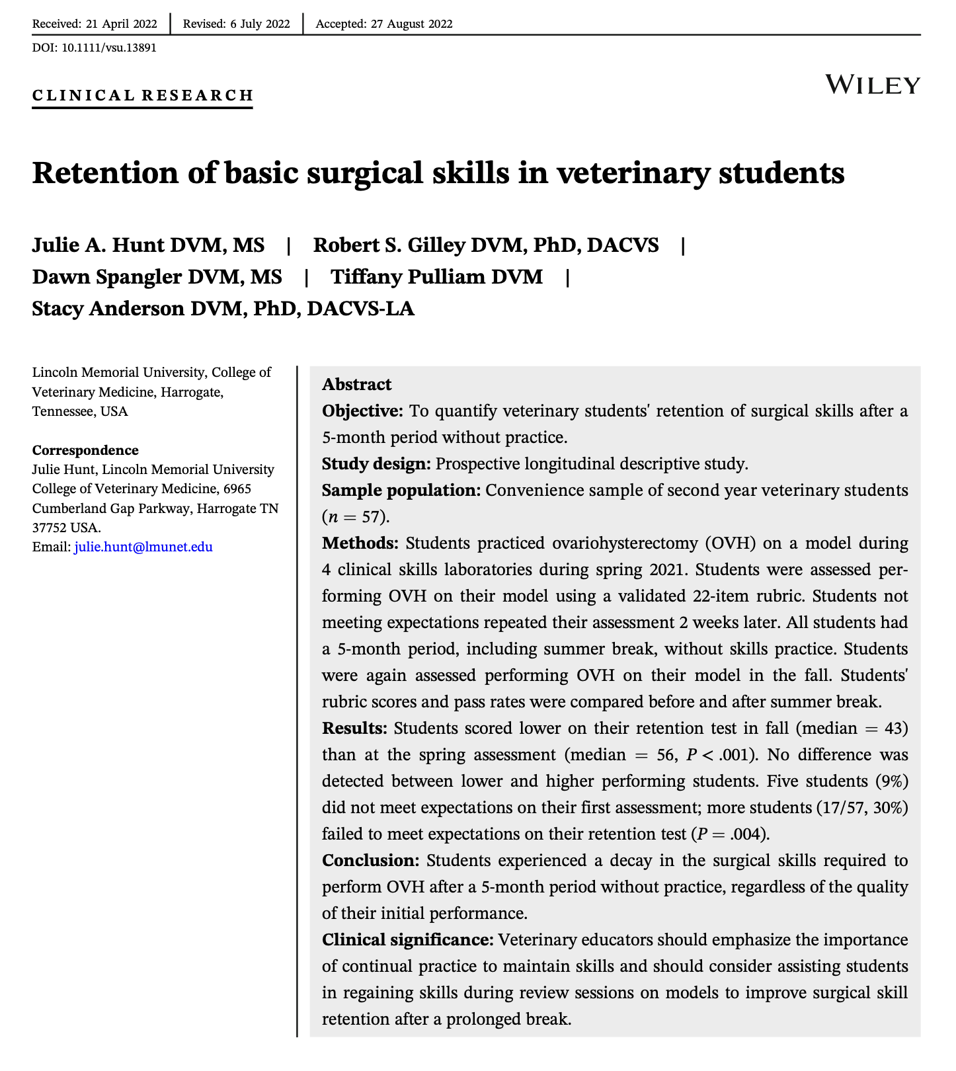
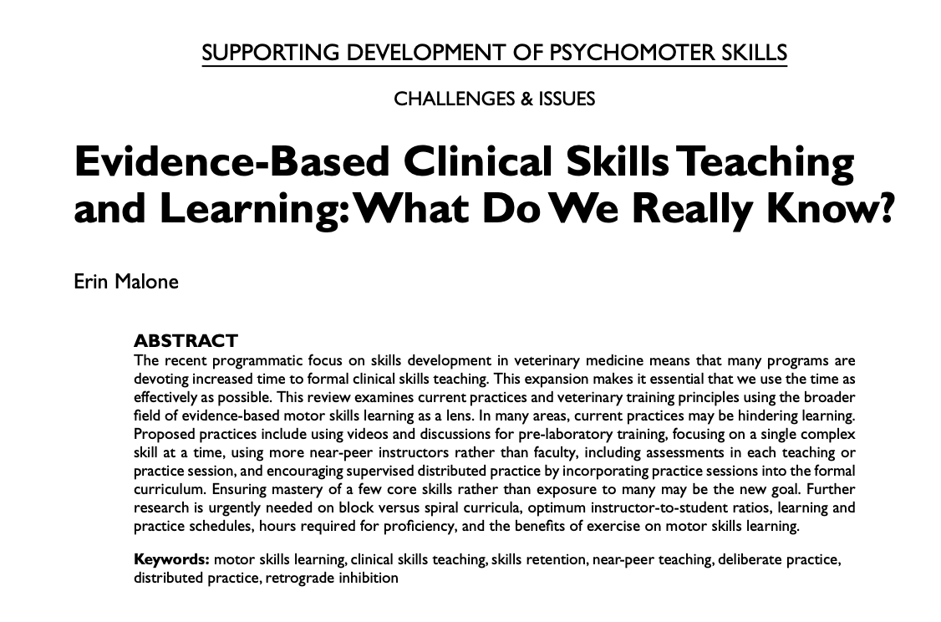
ITER 2 - Clinical Skills and Executive Functioning
doi: 10.1111/VSU.13891
doi: 10.3138/jvme.0717-094r1
2019. JVME 46(3)

Slide 13
ITER 3

Slide 14
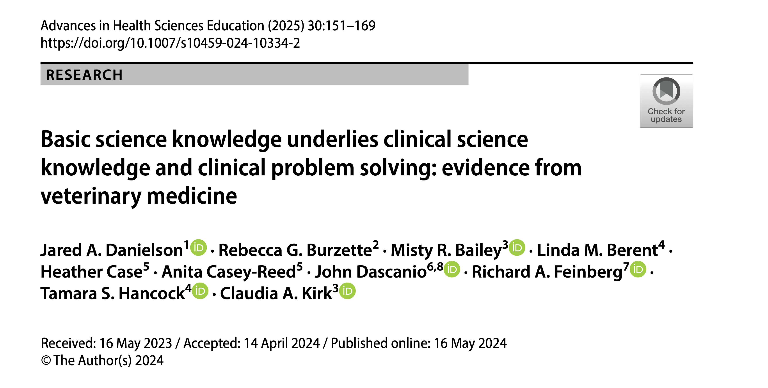
ITER 3 - Knowledge and Well-Being

Slide 15
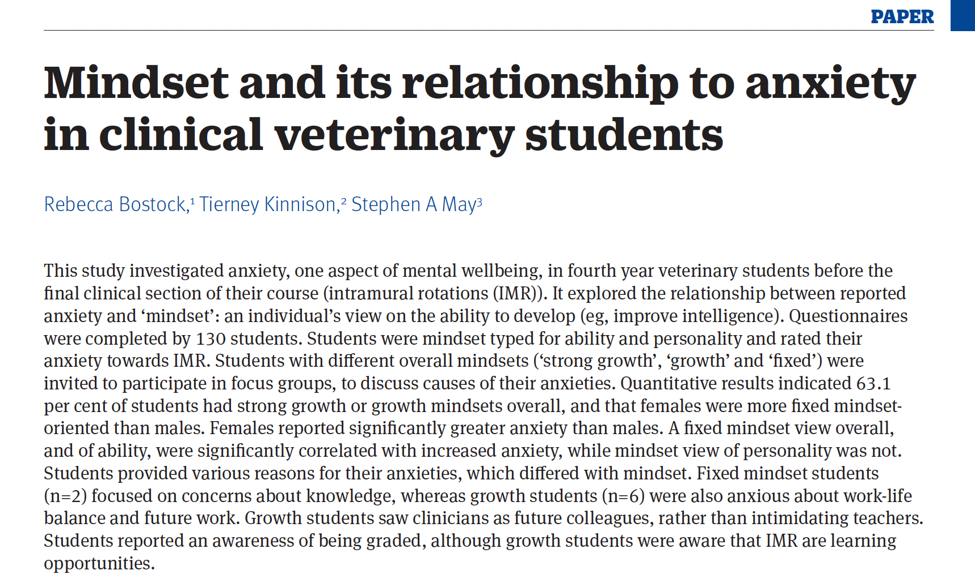
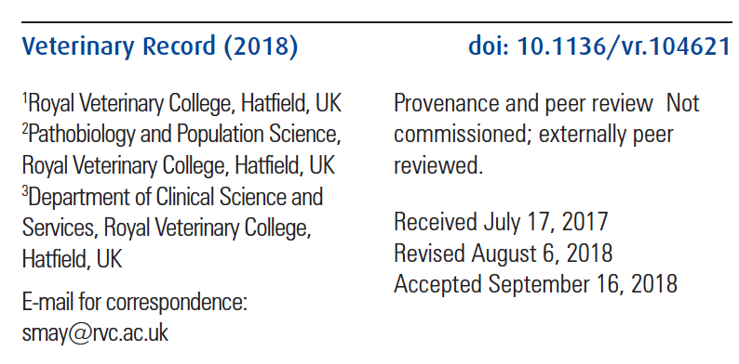
ITER 3 - Knowledge and Well-Being

Slide 16
Take Away Messages
ITER is one source of information - Affirm concerns with other data
Individual remediation plan needs to be created collaboratively
Clear expectations and timeline are essential
Documentation and record keeping are part of the plan
Don’t forget to support (and know when the issue is deeper than what it first seems)
Get your team ready before you need them!

Slide 17
Questions?
Thank you!!

